Slide 1
BIOSPHERE
The Region of the earth encompassing all living organisms both on the terrestrial surface (land), atmosphere and in the oceans
➢ plants, animals, and bacteria.
CONTRIBUTION TO CLIMATE:
1. distribution of energy produces an “effective temperature” of 16°C
2. provides planetary Mixture of homogeneous gasses(GHGs)
  CO2: respiration
  Methane: anaerobic bacterial decay
  Nitrous Oxide: aerobic release of nitrogen in soils
3. Moderates the hydrological cycle
4. create surface wind “Drag”
5. Strong impact on albedo
6. Carbon sinks (land, ocean)
* An attainment for national, regional, and global food security

Slide 2
https://www.youtube.com/watch?v=RDv42L8-soA
https://www.youtube.com/watch?v=gT4Jaa7Z6O8

Slide 3
Food Security
The state of having access to sufficient, affordable and nutritious food that ensures the population is in good health
1) Availability: according to the FAO, the impact of climate change on
this dimension will be mixed and vary regionally.
• Globally- increases in temperature between 1-3 degrees Celsius is projected to increase food production
flowering plants and vegetation respond differently but favorably to carbon increases.
Sunlight
Carbon dioxide (CO2) + water (H2O) -> carbohydrate (food) + oxygen (O2)
Groups: C3,C4
C3 plants are called temperate or cool season plants. Thrive between a temperature range of 18-24○C
rice, wheat, potatoes, most temperate crops, all woody trees.
C4 plants are often called tropical or warm season plants. Grow best between 32-35○C
corn, sugarcane, tropical climate plants, mostly grasses, some shrubs
Threats:
above 1-3C both C3 and C4 plants food production is projected to decrease.
This places an extra burden on SIDS whom are already facing food insecurity (inadequate domestic production, import issues and insufficient food aid)

Slide 4
Food Security
2) Access: the legal, political , economic and social structure that enable individuals to acquire food.
3) Supply stability: having adequate food at all times even during economic or environmental challenges.
Threats: more intense extreme events and shifting patterns in droughts, floods and cyclones all affect those two dimensions. Loss of cultivated land and fish nursery
4) Utilisation: consumption of foods leading to the achievement of a state of good health.
Threats from climate change: increase in water scarcity, contamination of potable water and increases in vector-borne diseases by climate change, lowers the human capacity to utilise food effectively. particularly in sub-tropics

Slide 5
Food Security
The more dependent people/country are on livelihoods vulnerable to climate change remain the worst impacted.
• Decrease of food insecurity depends on reducing said vulnerabilities.
• For most vulnerable- food security impacts felt through reduced access and stability
The reduction of underlying vulnerabilities is put forward by literature as “key” to reducing impacts on food security.
• Consideration of one’s climate is therefore critical in understanding these vulnerabilities.

Slide 6
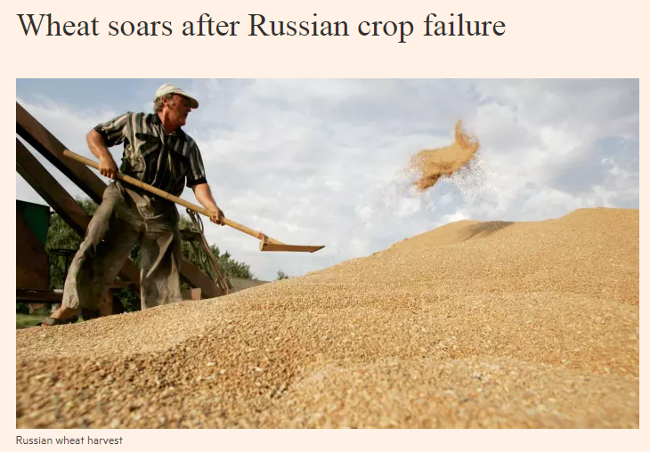
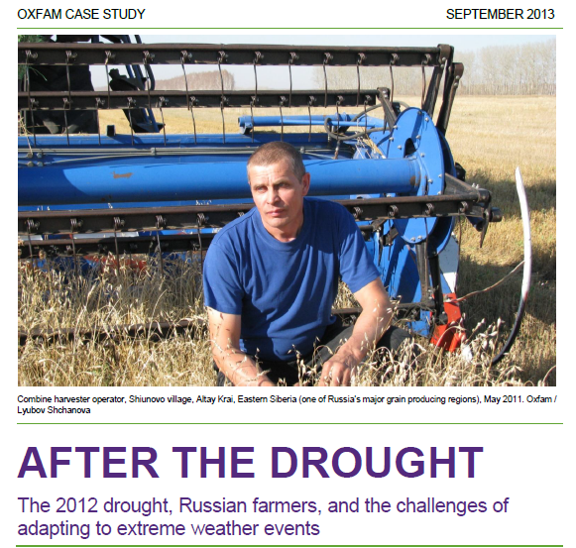
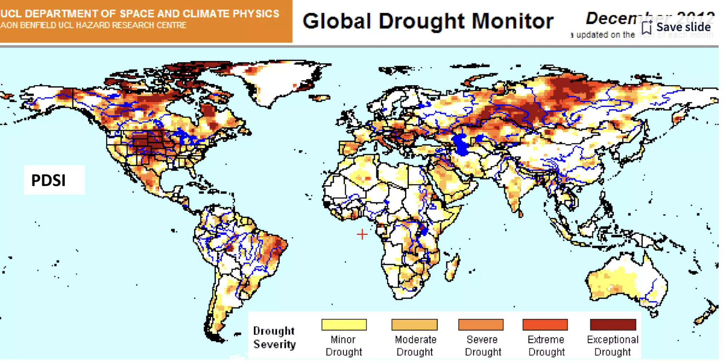

Slide 7
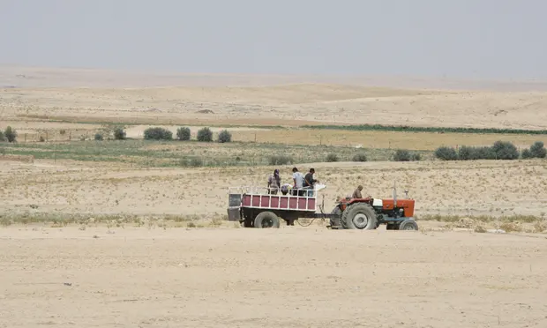
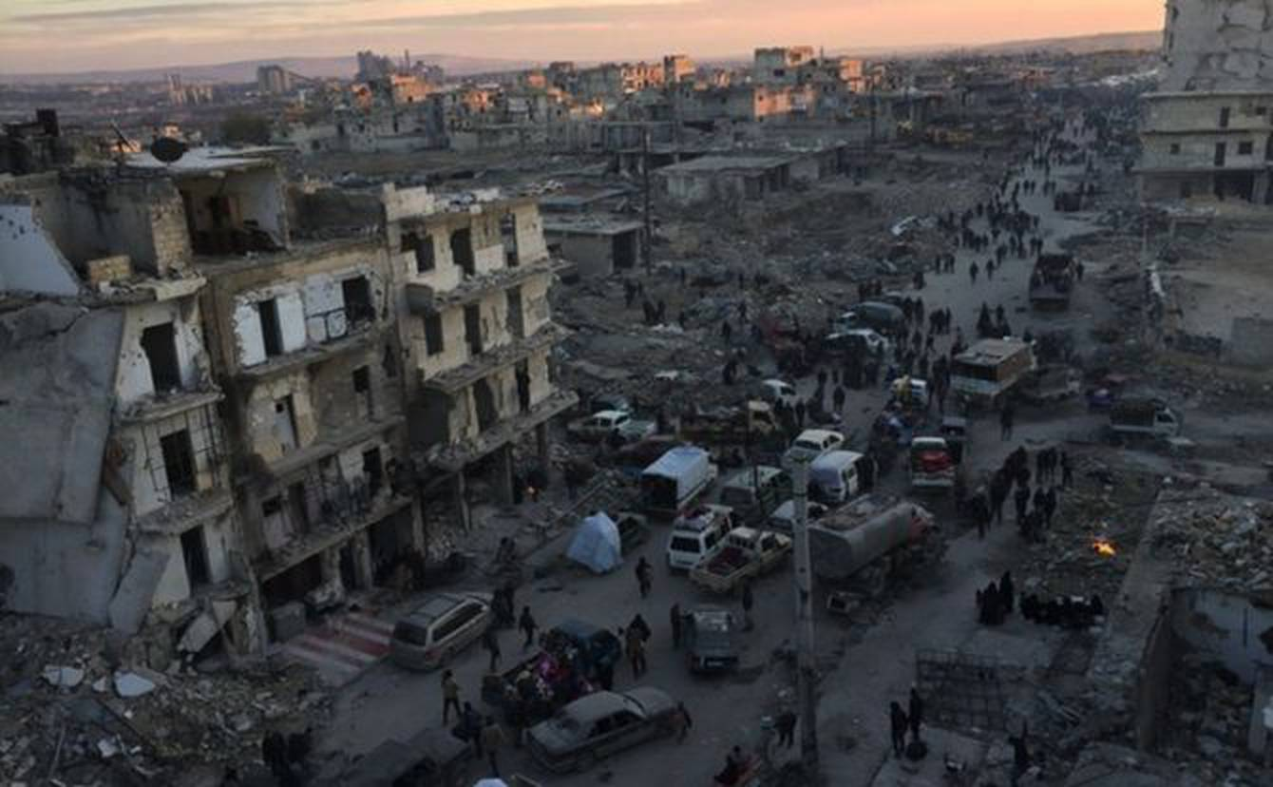
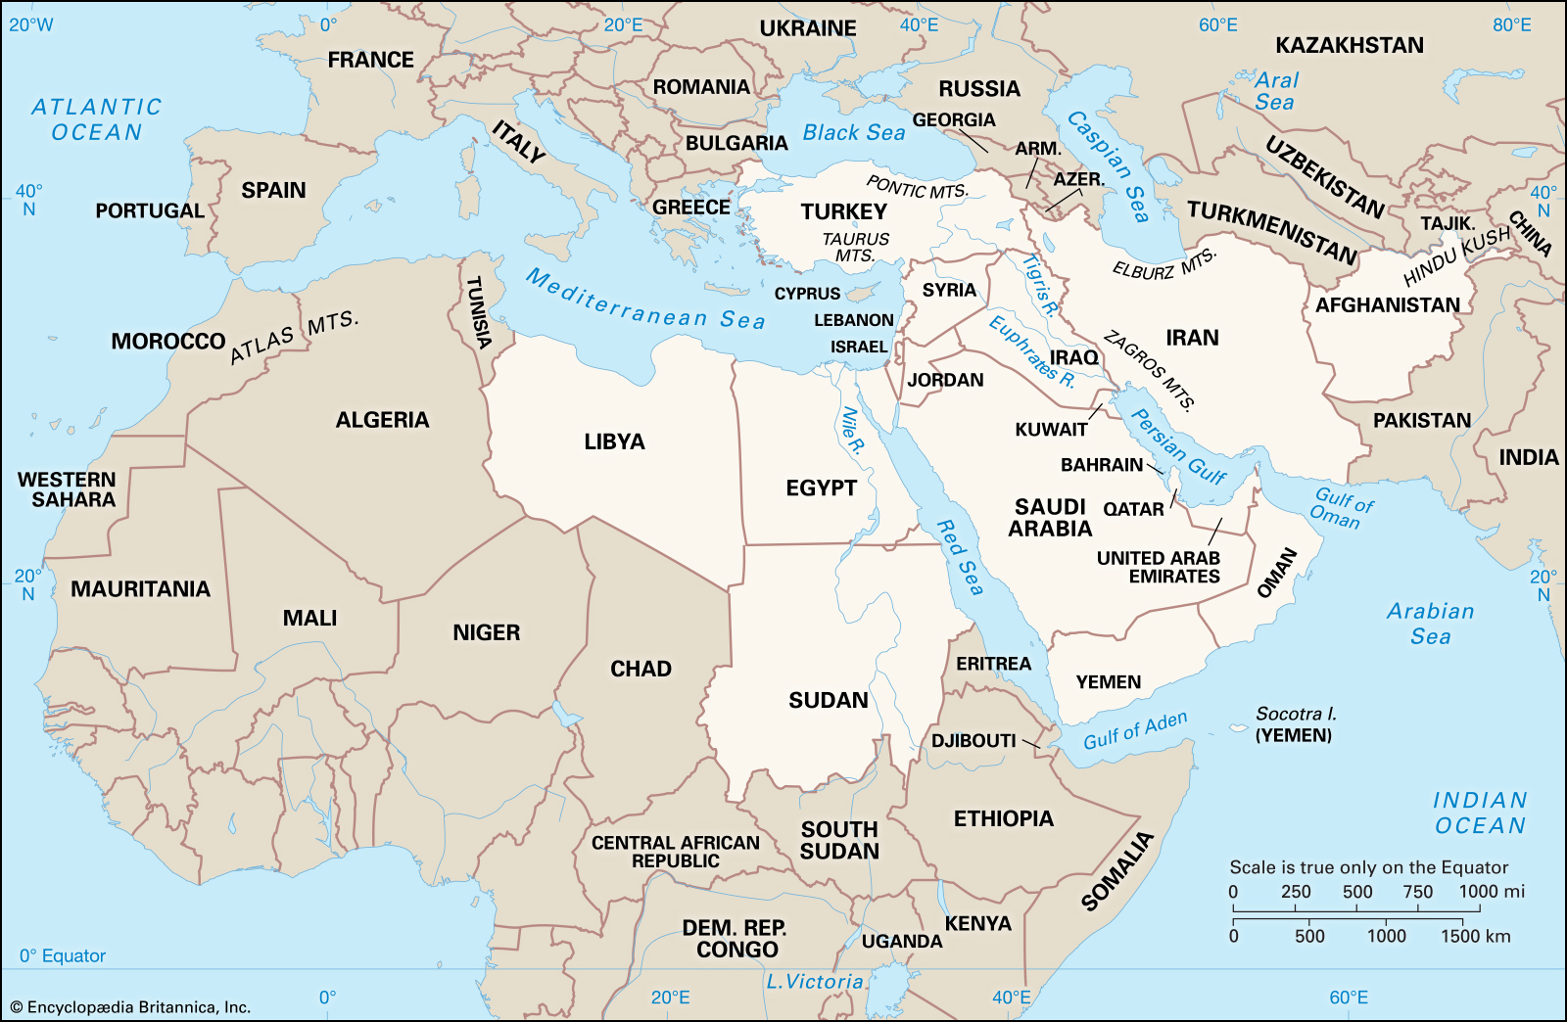
Syria: drought wars
“…the importance of resilience, and how spectacularly a society can break and fracture when climate-forced events exceed the capacity to adapt.” -- David Titley, director of Penn State's Center for Solutions to Weather and Climate Risk and retired Navy Rear Admiral
https://www.climatecentral.org/news/climate-change-contributing-factor-syrian-conflict-18718
https://theconversation.com/is-syria-really-a-climate-war-we-examined-the-links-between-drought-migration-and-conflict-80110

Slide 8
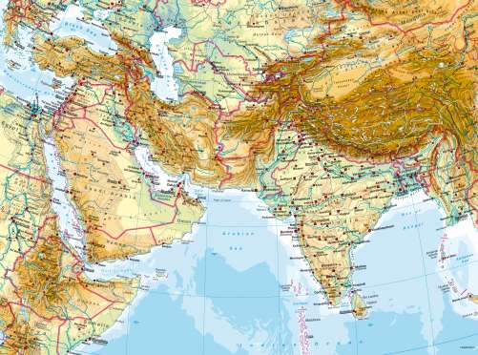
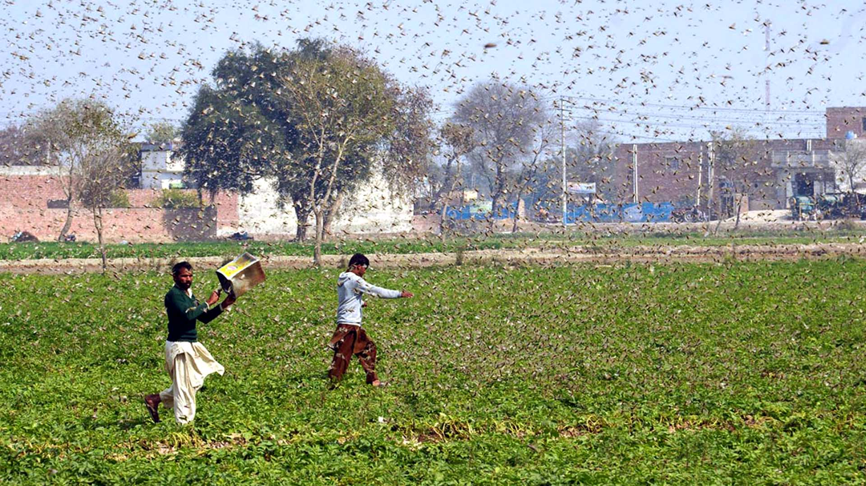
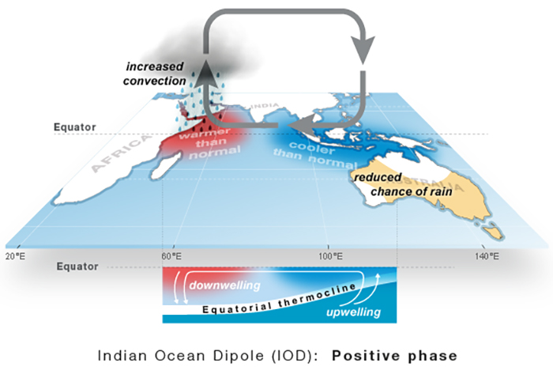
India: worst locust attacks in 26 years
Indian Ocean Dipole (IOD): shifting sea surface temperature pattern
https://www.hindustantimes.com/india-news/worst-locust-attack-in-26-years-all-about-the-latest-threat-amid-covid-19-outbreak/story-HCSl5S2bvqQT3mIeWijOsL.html

Slide 9
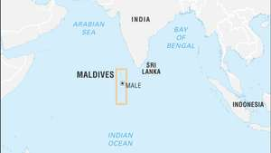
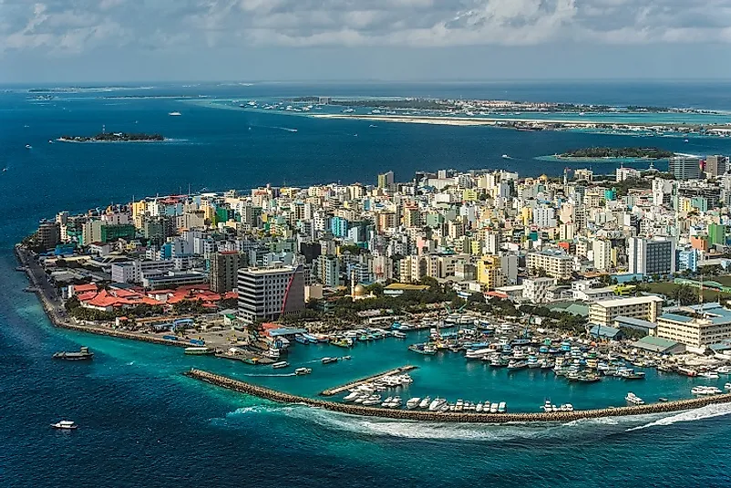
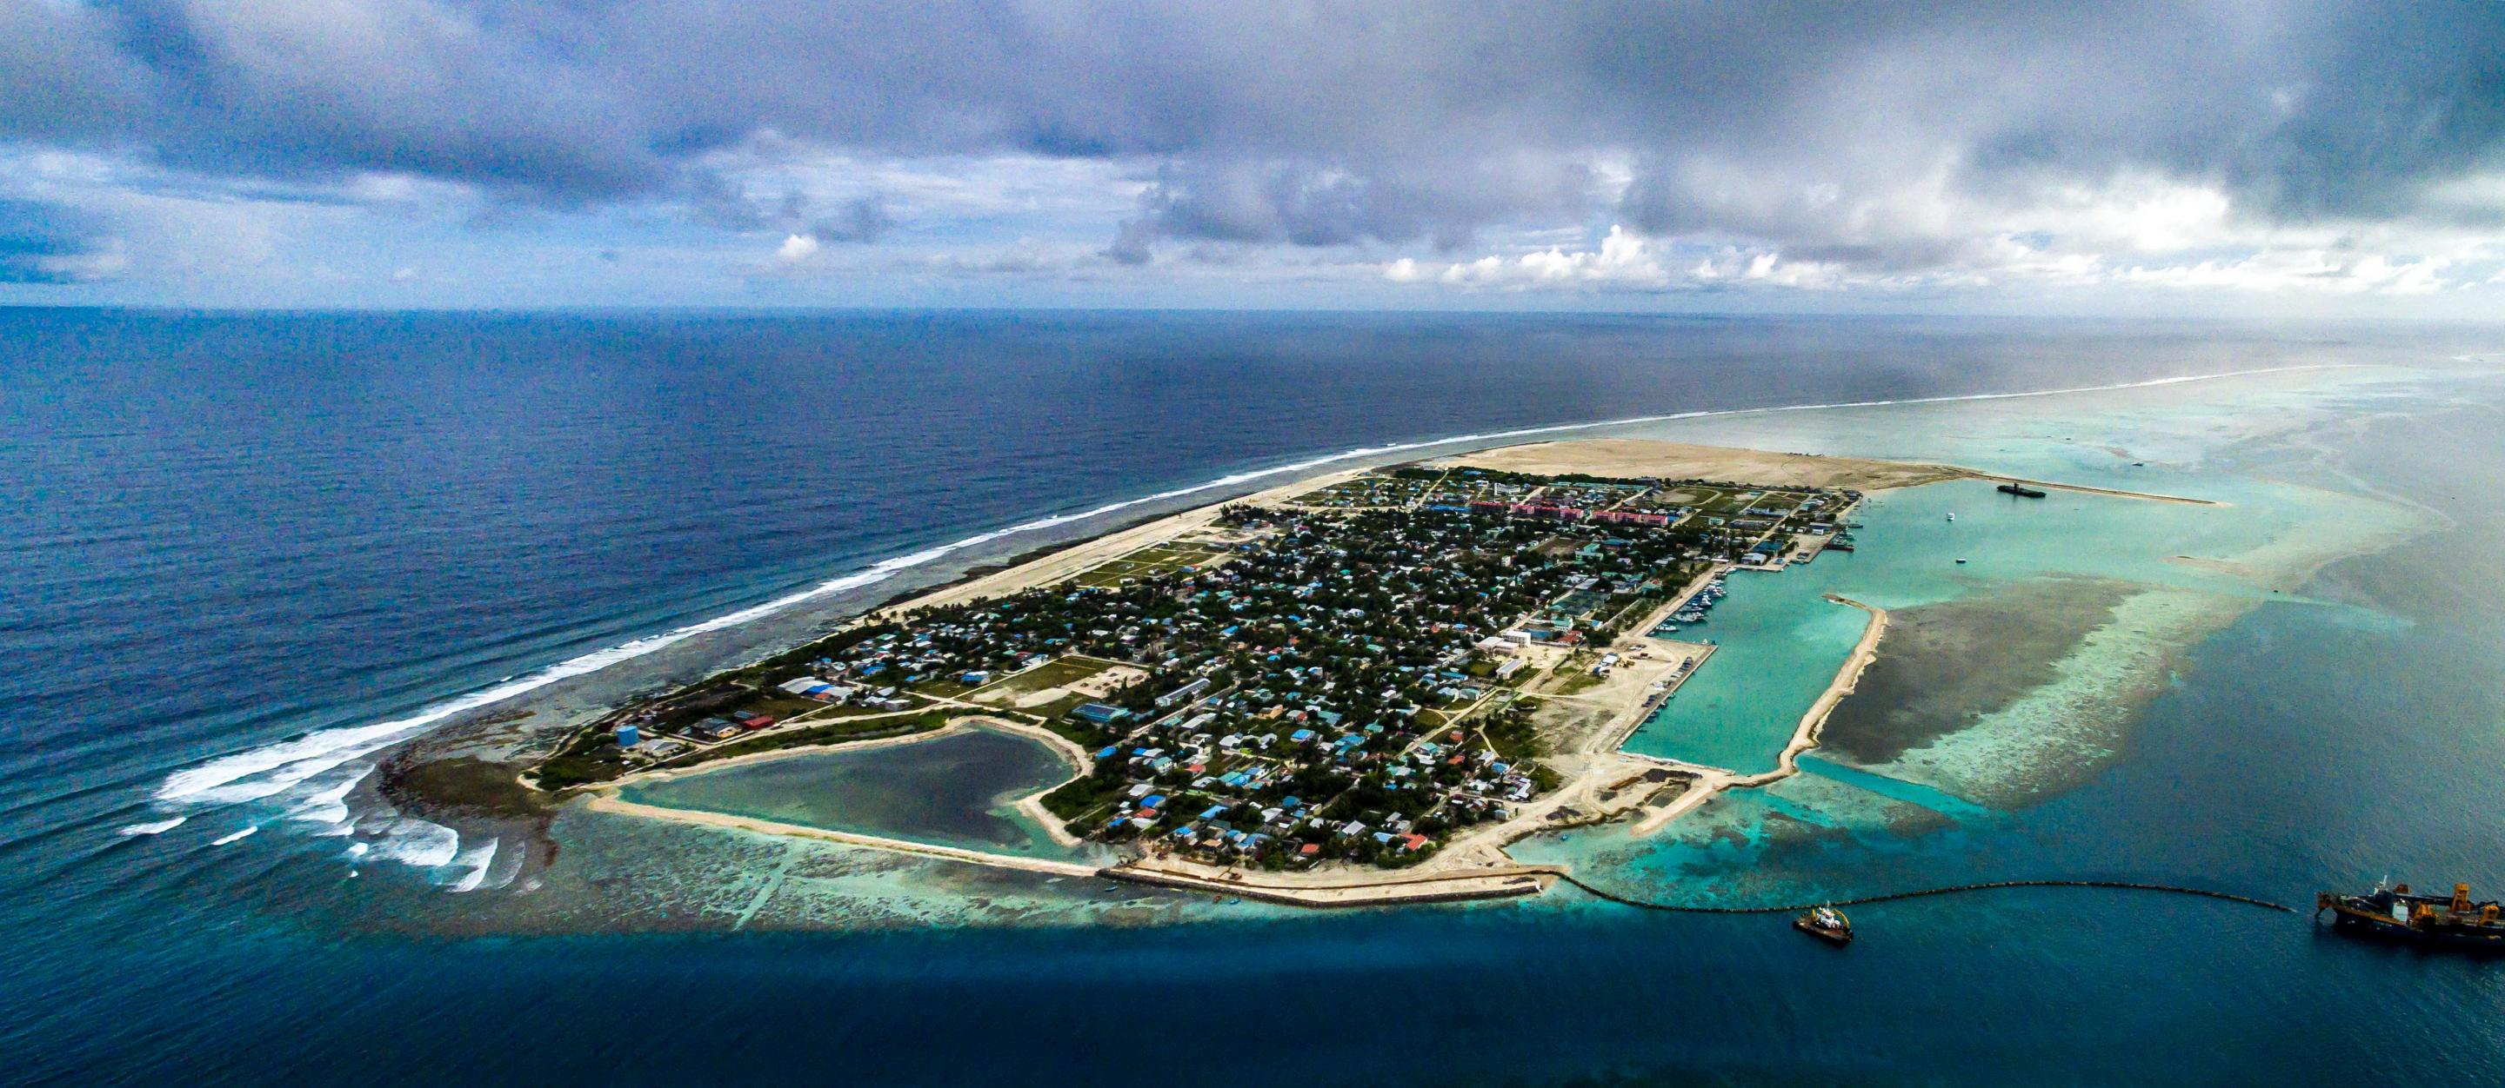
The Maldives: Over 80 per cent of the land area is less than one meter above mean sea level
https://www.reuters.com/article/us-climate-change-maldives-idUSKBN1ZG0XS
https://luxurylondon.co.uk/travel/international/is-it-too-late-too-save-the-maldives-from-the-effects-of-climate-change

Slide 10
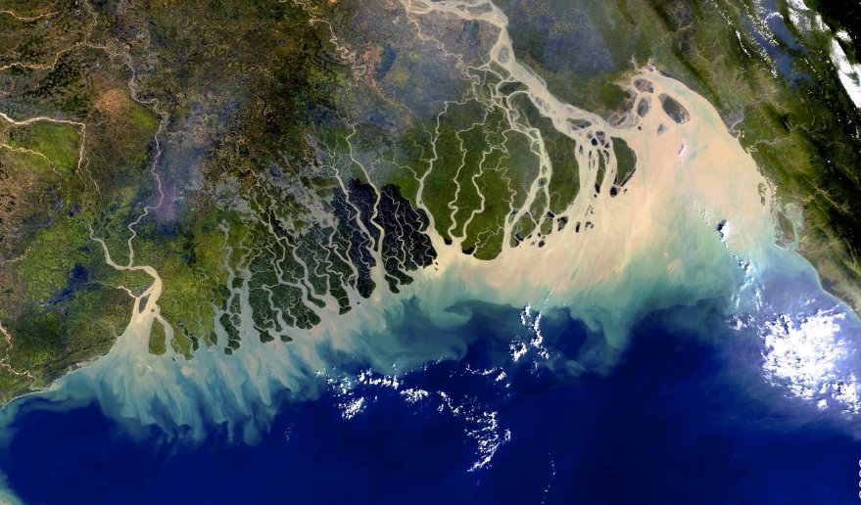
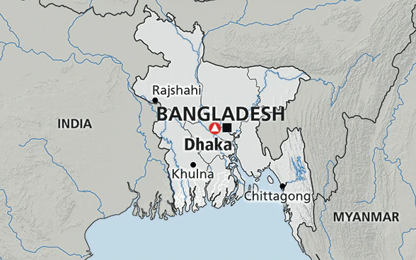
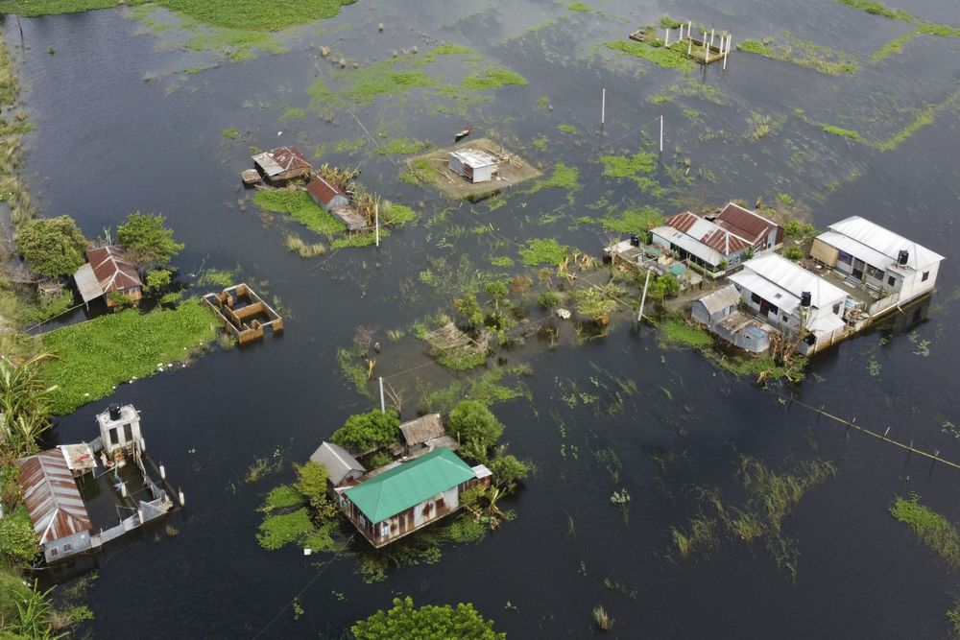
Bangladesh: flat, low-lying, and delta-exposed topography, and socio-economic factors, including its high population density, levels of poverty, and dependence on agriculture.
It has been estimated that by 2050, one in every seven people in Bangladesh will be displaced by climate change. Up to 18 million people may have to move because of sea level rise alone.
https://www.bbc.com/news/world-asia-56485667
https://www.bloomberg.com/news/articles/2020-08-24/bangladesh-to-kickstart-climate-change-plan-with-2-billion-loan

Slide 11
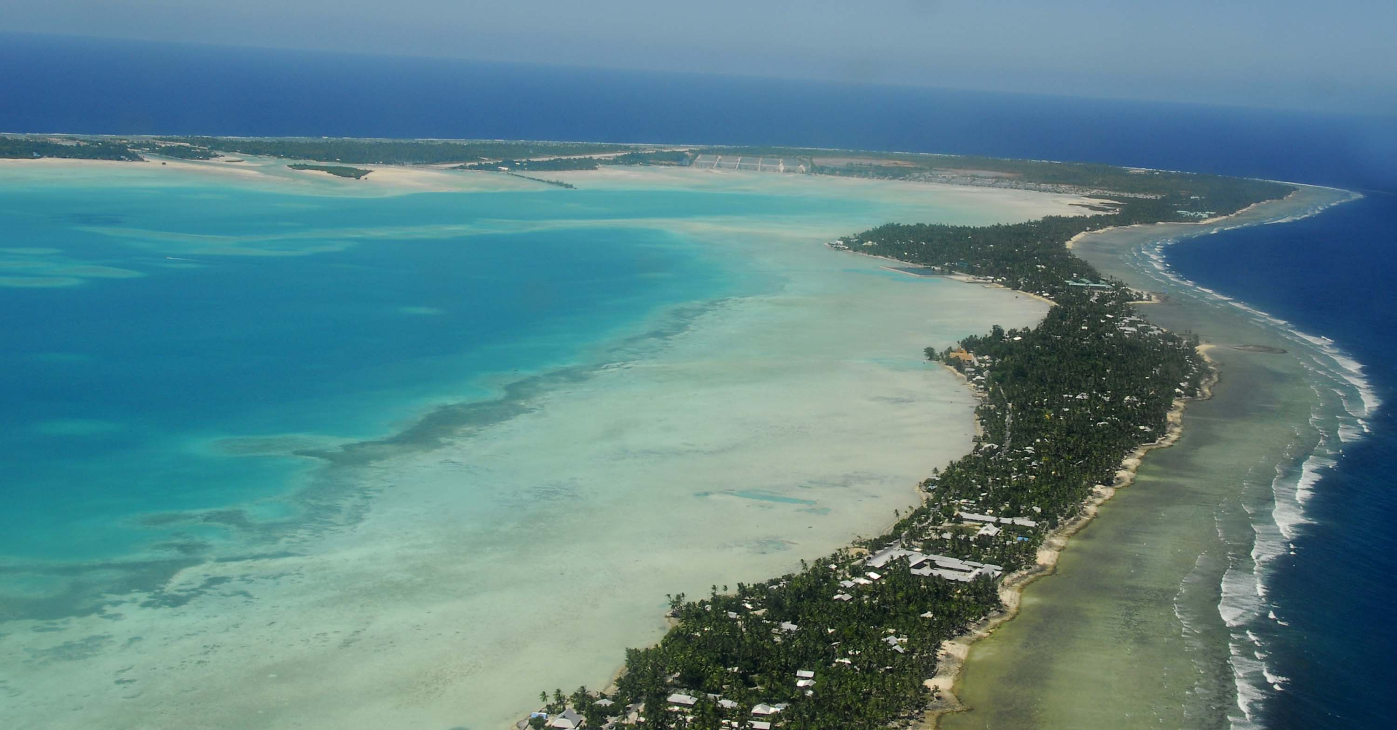
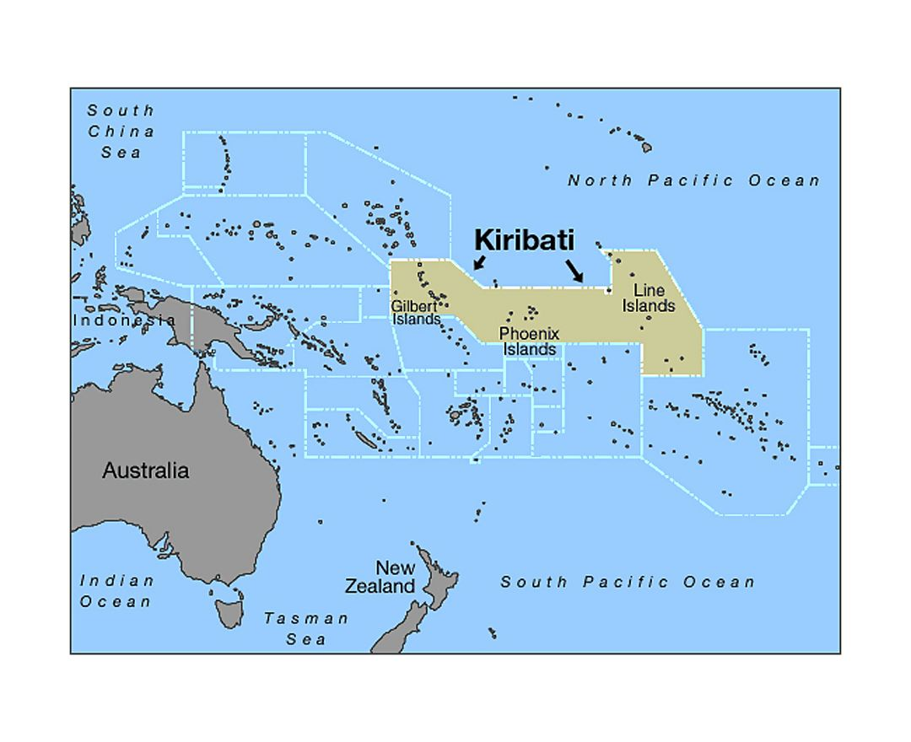
Kiribati: 33 islands, climate migration
https://www.youtube.com/watch?v=plzBaNaCIv4

Slide 12
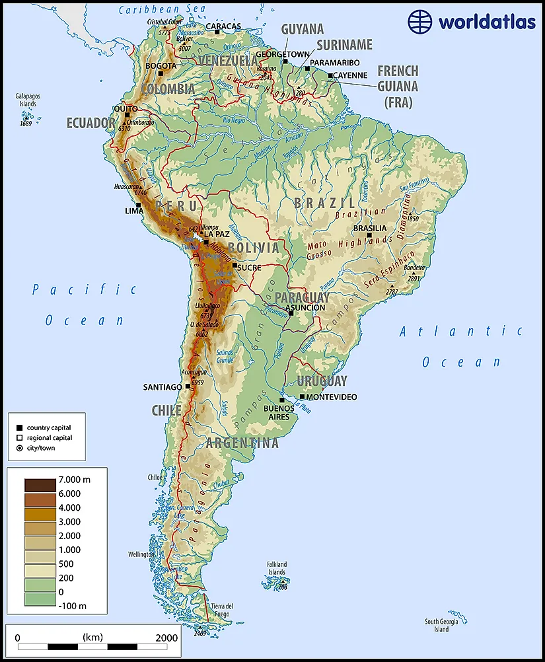
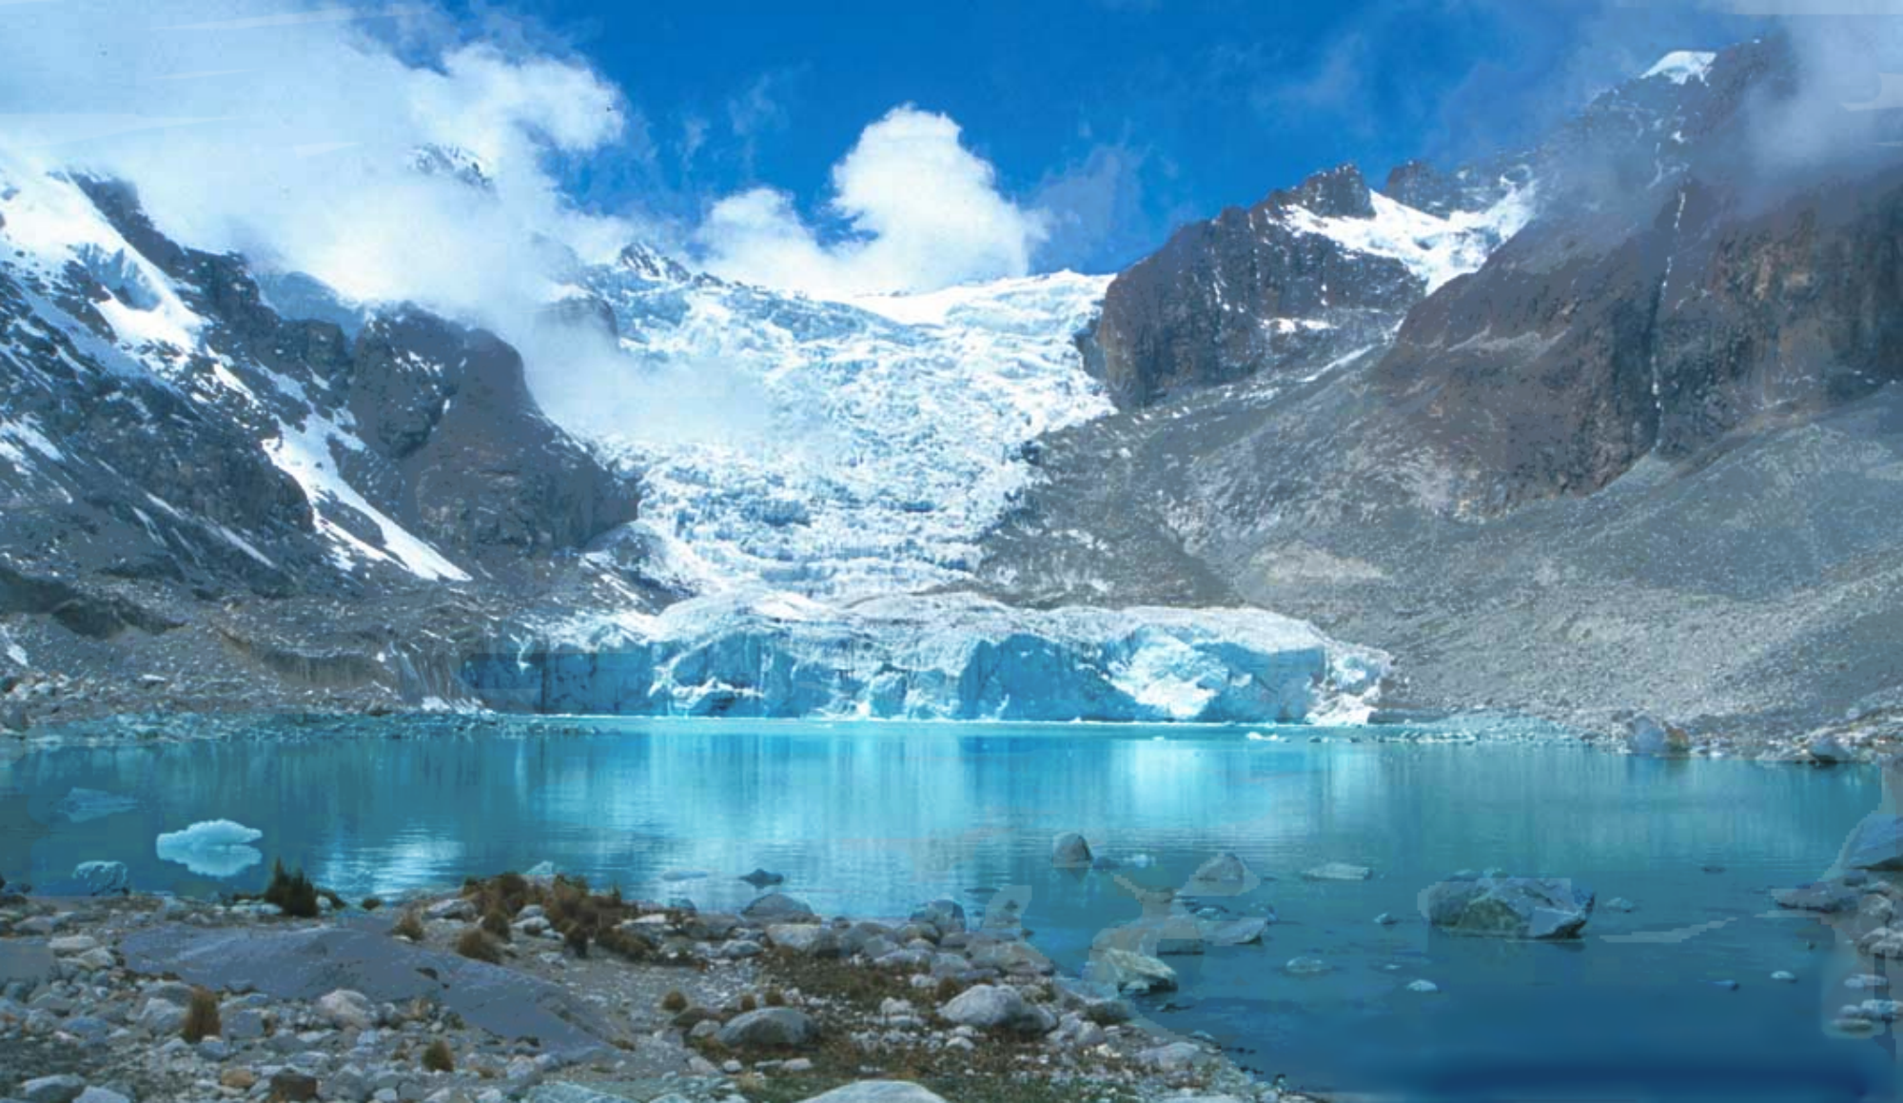
Bolivia: Glaciers in the tropical Andes have shrunk faster over the past 30 years because of climate change.
https://www.reuters.com/article/us-bolivia-environment-glacier-idUSKBN29929U
https://mondediplo.com/2020/08/06bolivia#:~:text=It%20predicts%20that%20Venezuela's%20last,the%20end%20of%20the%20century.

Slide 13
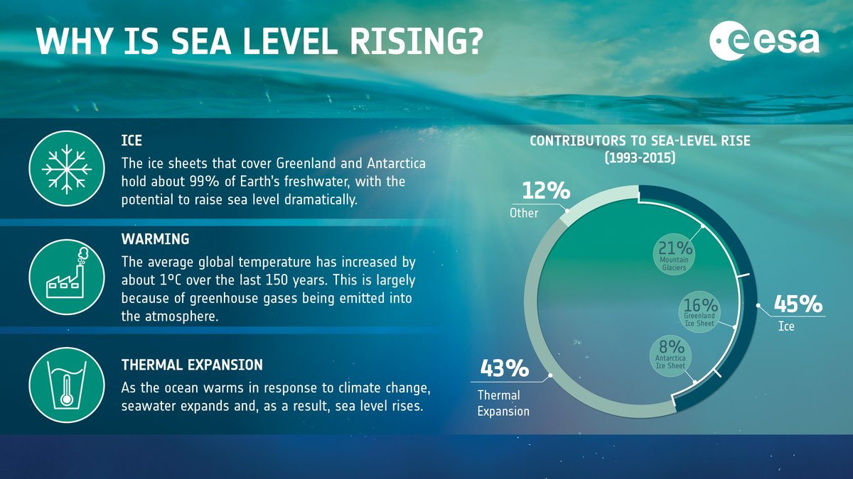
Thermal Expansion

Slide 14
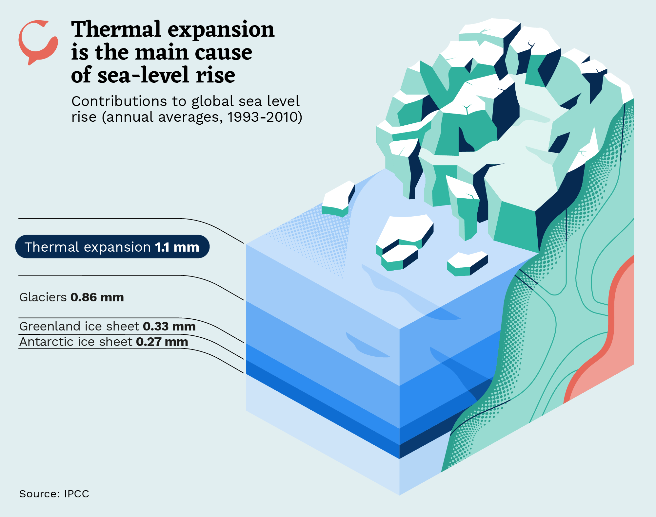
Thermal Expansion

Slide 15
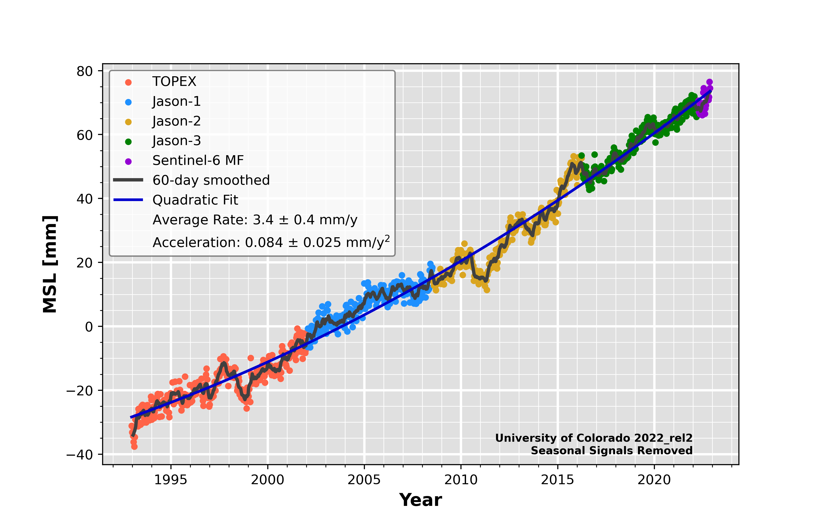

Slide 16
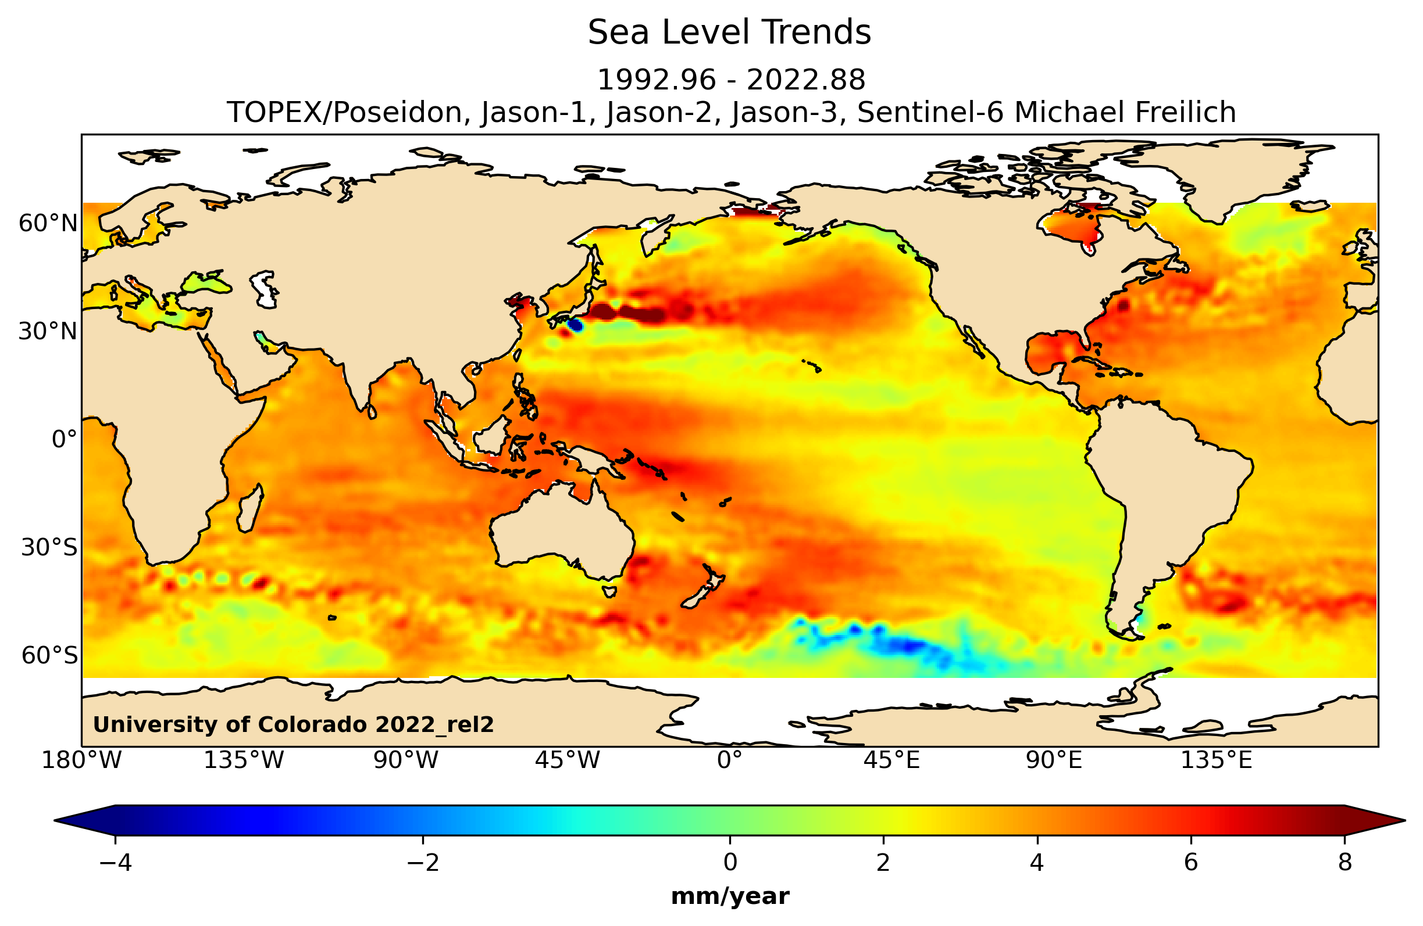

Slide 17
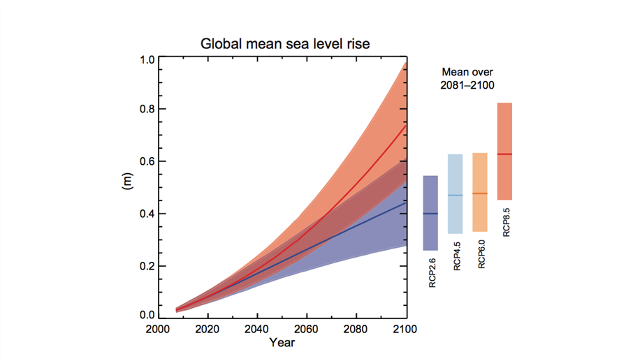
https://ccar.colorado.edu/altimetry/

Slide 18
Regions Susceptible to Sea Level Change
Rising sea levels will affect nearly everyone on the planet in one way or another, but people living in coastal areas will be touched first/most. Three areas we will consider here:
Low-lying, developing nation (ex. Bangladesh)
Coastal urban area (ex. Southern California)
Small island nations (ex. Maldives)

Slide 19
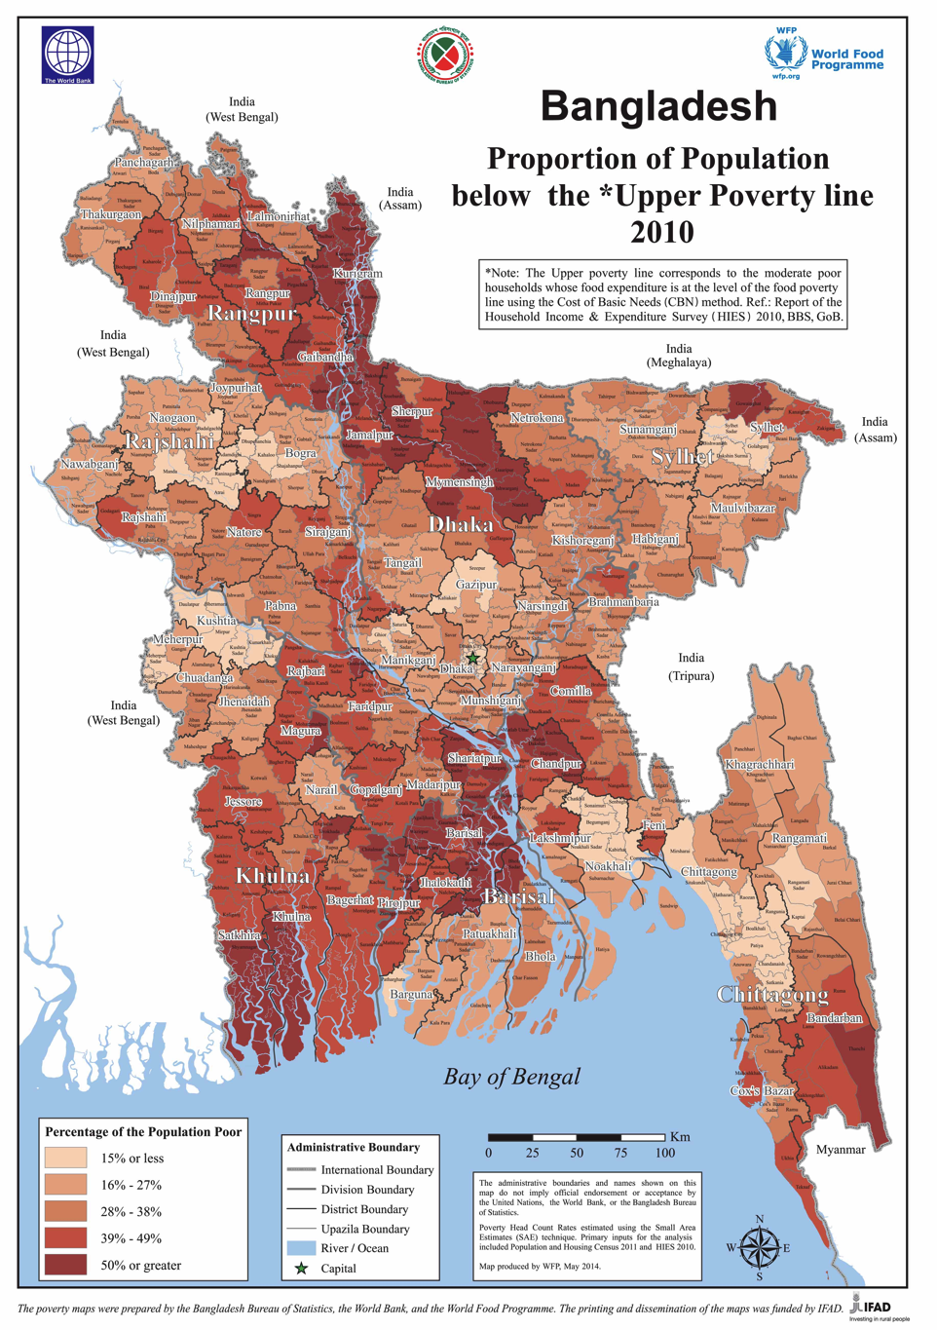
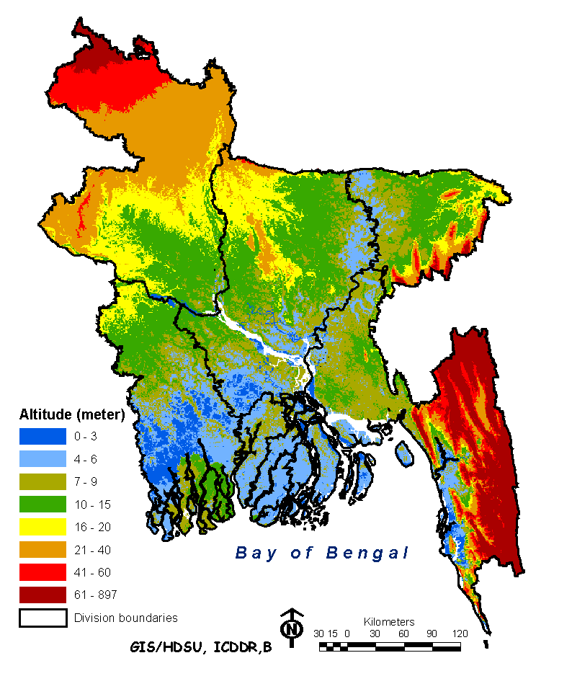
Bangladesh
Notes:
Bangladesh is a low-lying developing nation with a significant population below the poverty level and large areas of land within 0-10 meters of sea level and thus susceptible to increased flooding associated with sea level rise and changing rain patterns.
Images left to right:
Map of Bangladesh depicting proportion of population below poverty. Image: http://www.worldbank.org/en/news/press-release/2014/08/27/latest-bangladesh-poverty-maps-launched (World Bank has released under creative commons license)
Elevation map of Bangladesh, International Centre for Diarrhoeal Disease Research, Bangladesh (http://dspace.icddrb.org/jspui/; publications open for reuse) - Health and Demographic Surveillance SystemHealth and Demographic Surveillance System Report 2009
Google Earth image of the location of Bangladesh in Asia

Slide 20
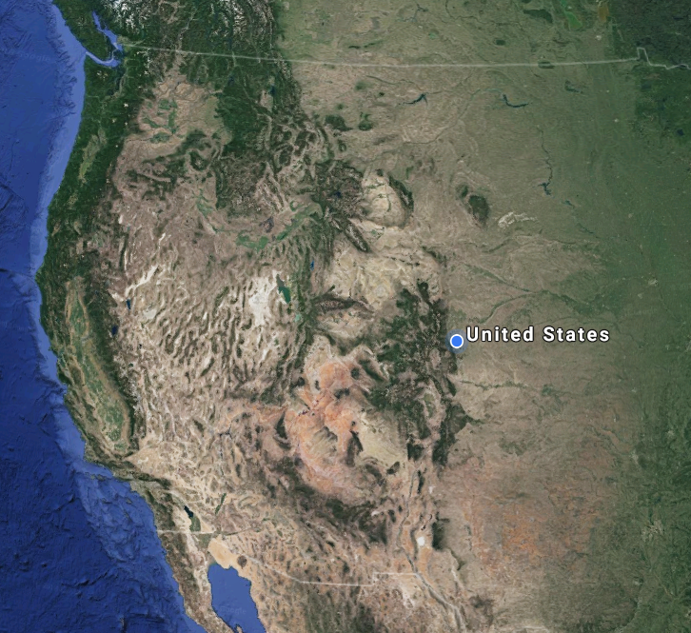
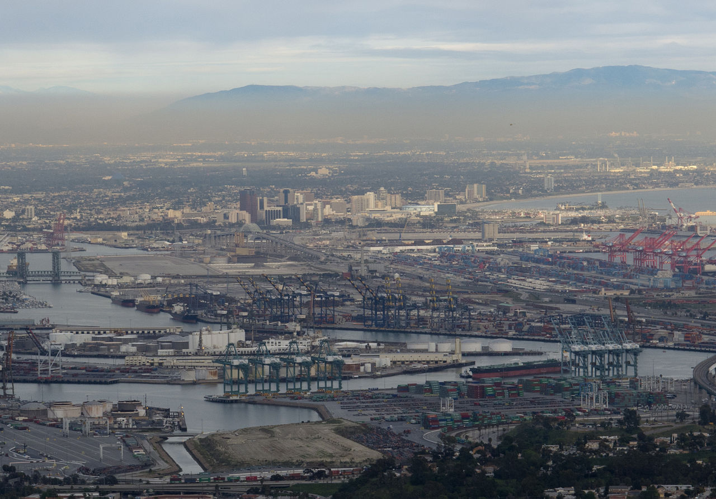
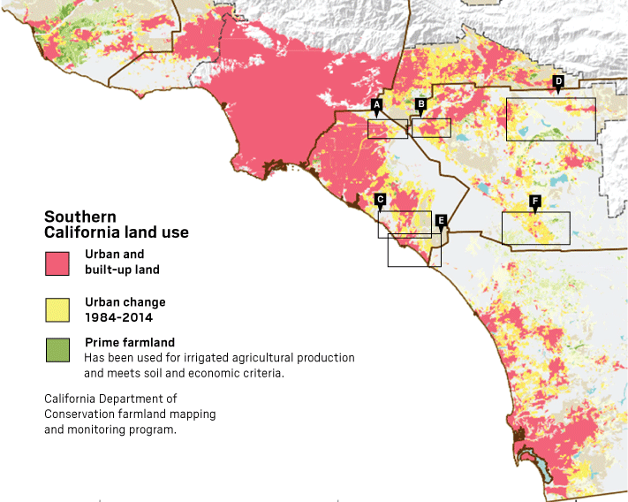
Southern California
Notes:
Southern California gives an example of the types of societal infrastructure are vulnerable to sea level change in many coastal cities around the world. Besides large populations, coastal cities have critical infrastructure such as ports, railways, roads, power plants, and water treatment facilities.
Images
Upper left: https://en.wikipedia.org/wiki/Port_of_Los_Angeles#/media/File:LA-port%2BLong-Beach1.jpg
Upper right: Google Maps
Lower: CA Dept of Conservation farmland mapping and monitoring program

Slide 21
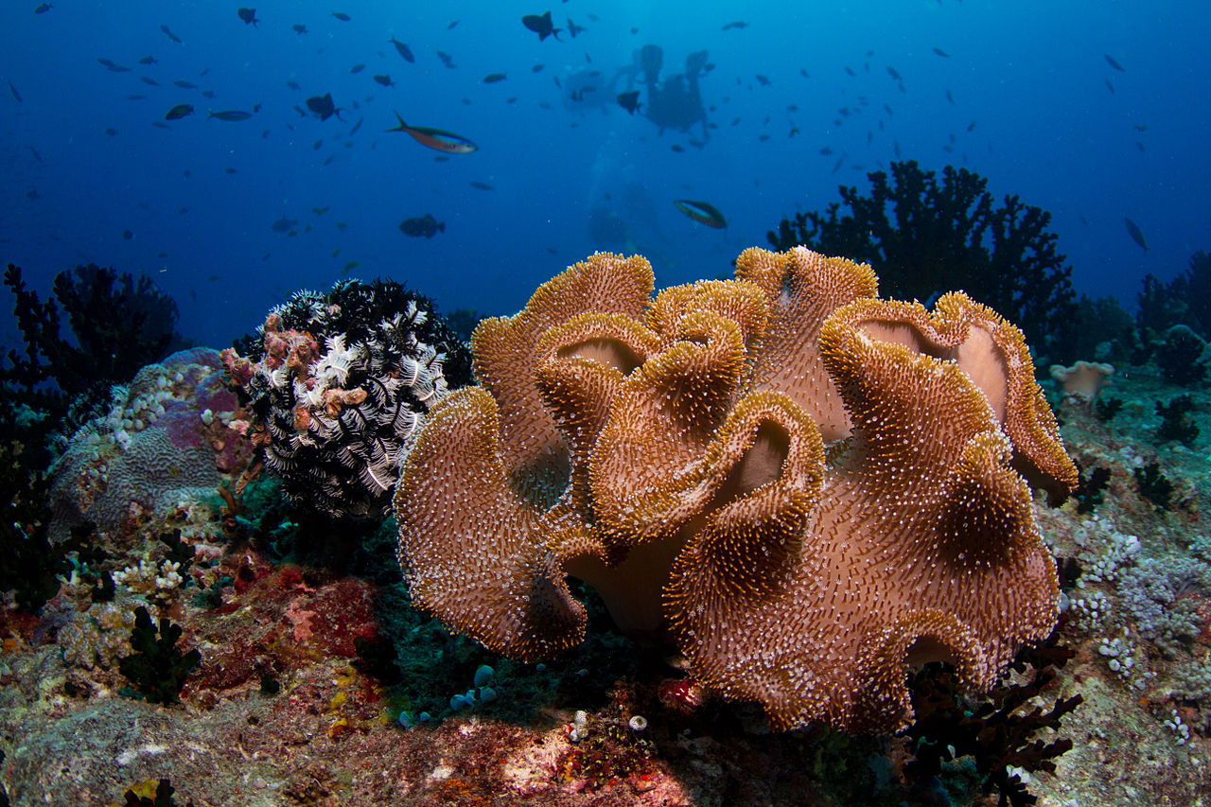
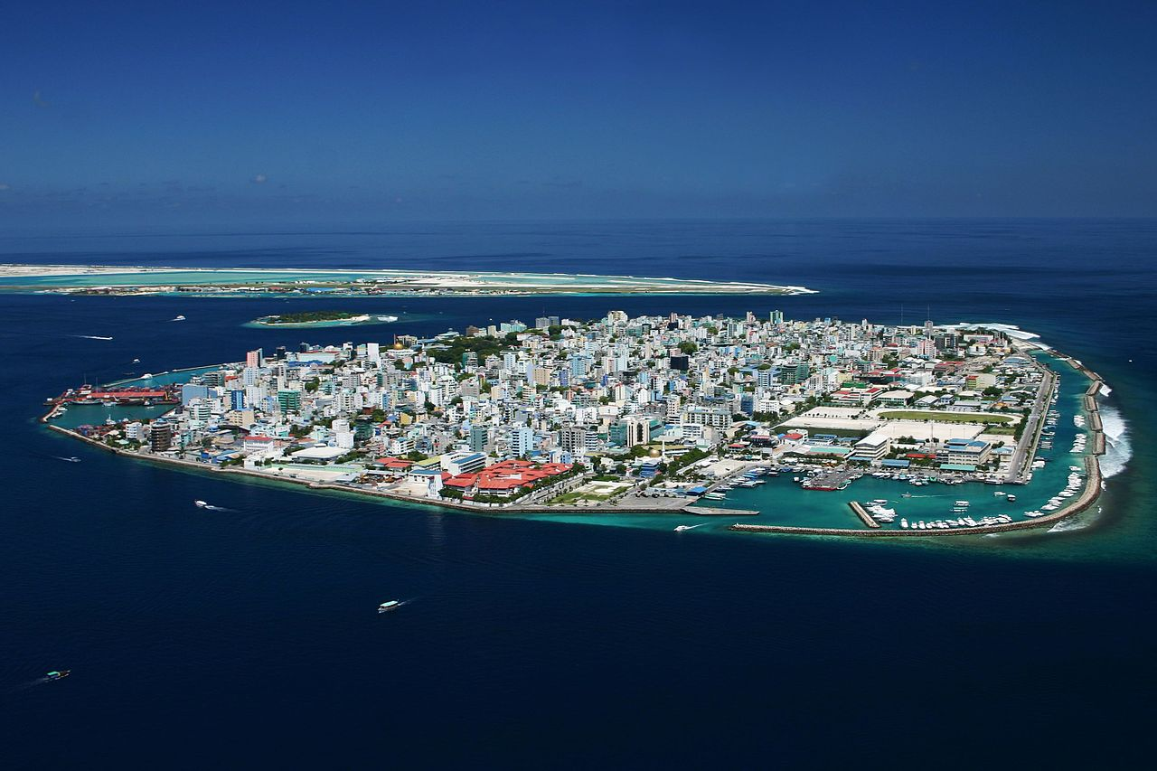
Maldives
Notes:
Some of the islands in the world simply do not have land of high enough elevation land to be above sea level if levels rise. Maldives is an inland nation southwest of India with a high point of 2.4 meters above sea level and an average elevation of 1.5 meters. Great diversity of marine resources are found around the islands. The populated islands themselves have very dense population and societal infrastructure.
Images
Malé : By Shahee Ilyas - Own work, CC BY-SA 3.0, https://commons.wikimedia.org/w/index.php?curid=621195
Corals: By Tchami - Maldives, CC BY-SA 2.0, https://commons.wikimedia.org/w/index.php?curid=34516229
Overview: Google Earth

Slide 22
Questions related to sea level change impacts
Greenhouse gas emissions are implicated as the major contributor to climate change and sea level rise. Industrialized countries contribute significantly more greenhouse gases than poorer, developing countries; similarly, within developed nations the poor or rural communities often have fewer resources to respond to sea level changes. For example, the United States is responsible for approximately 23% of global carbon dioxide emissions annually. What (if any) role should developed countries like the United States take in assisting those communities impacted by sea level change?
There are two major strategies proposed to address the effects of sea level rise: 1) Mitigation, a strategy by which steps are taken to stop or slow down sea level rise 2) Adaptation involves seeking out ways to adjust to sea level rise if it seem unavoidable. Do you believe that mitigation or adaptation is a more feasible strategy for the community in your reading? Why? What about in for your community? Why?
Notes:
Questions the students were asked in the pre-class homework.
OPTIONAL: You may wish to start class with some discussion of how students answered the questions

Slide 23
Stakeholder Analysis
According to the Project Management Institute (PMI), the term project stakeholder refers to, “an individual, group, or organization, who may affect, be affected by, or perceive itself to be affected by a decision, activity, or outcome of a project”.
Purpose of a Stakeholder Analysis is “to identify and understand different persons, groups, and institutions who will be positively or negatively impacted”.
Notes:
Project Management Institute, 2013, Project stakeholder - Wikipedia, the free encyclopedia https://en.wikipedia.org/wiki/Project_stakeholder

Slide 24
Potential Stakeholders
Local communities/residents
Commercial entities (e.g. manufacturing, transportation, fishing, tourism, agriculture)
Governmental agencies (e.g. city, state, and national)
Fossil fuel users (e.g. electrical power consumers, vehicle transportation)
Fossil fuel producers (e.g. companies that extract coal, oil, or gas)
International organizations & NGOs (e.g. IPCC, United Nations, Climate Action Network)
Societal infrastructure organizations (e.g. water suppliers, power suppliers, schools, hospitals)
Scientific organizations (e.g. research institutes, NOAA, NASA)
Notes:
These are possible stakeholder groups but hopefully students will come up with a similar list but you could refer to this for ideas to consider.
Note: NGO = non government organization

Slide 25
Example Corporate Stakeholder Cross Plot of Interest vs Power/Influence
Finance
CEO
Legal
Networking & security
Project Manager
Web standards team
Development team
Power/Influence
Outsourced center manager
Outsourced center staff
Testers
Training Manager
Customers
Interest
Notes:
Example Stakeholder Analysis cross plot of interest verses power with the relative position of various stakeholders shown – corporate example. Additional plots could be set up with other criteria selected for comparison such as impact, engagement, resources, direct, indirect, and legal requirements.
Adapted from http://www.stakeholdermap.com/stakeholder-analysis.html

Slide 26
Stakeholder Cross Plot of Interest vs Power/Influence
Power/Influence
Interest
Notes:
Plot where the class’s ideas can be recorded here as a way to think through the relative interest vs power.

Slide 27
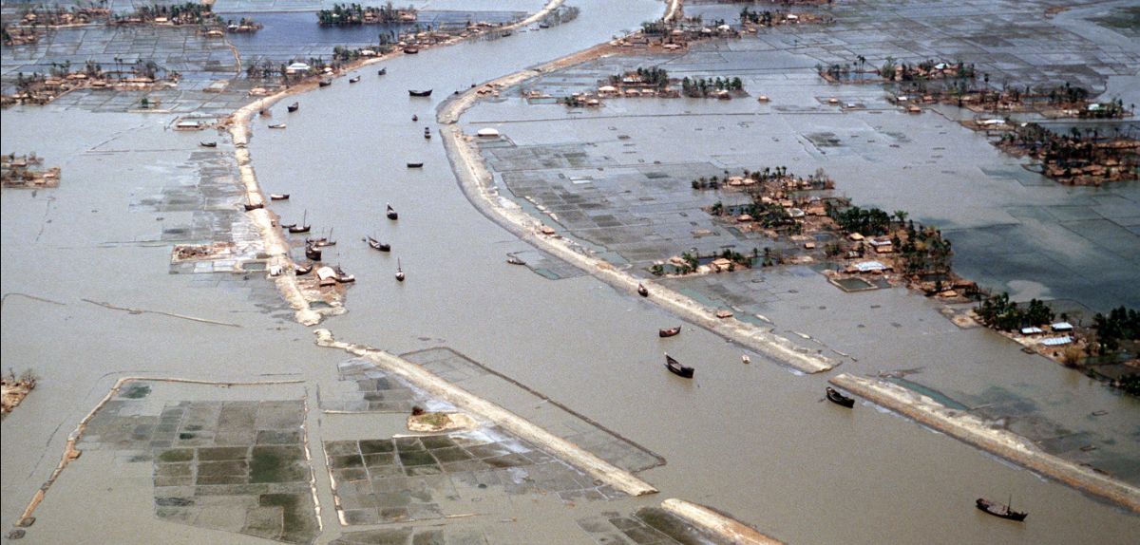
Coastal Flooding in Bangladesh –
What to do about it?
Continue to make meager adaptations to stem the loss of life in the face of increasingly frequent severe weather events?
Continue to appeal to high carbon emitting states to stem the output of atmospheric green house gasses in an effort to save their country from destruction.
Notes:
You may wish to choose one or the other from this or the next slide if you wish to engage the students in a discussion about the posed questions.
Flooded villages and fields around a river in Bangladesh the day after the 1991 Bangladesh cyclone had struck the country. Floods like this will become more common as climate change and sea level rise continue.
Image source: Staff Sergeant Val Gempis (USAF). Image from the Defense Visual Information Center, ID number DFST9206136. https://commons.wikimedia.org/wiki/File:Flooding_after_1991_cyclone.jpg (public domain)

Slide 28
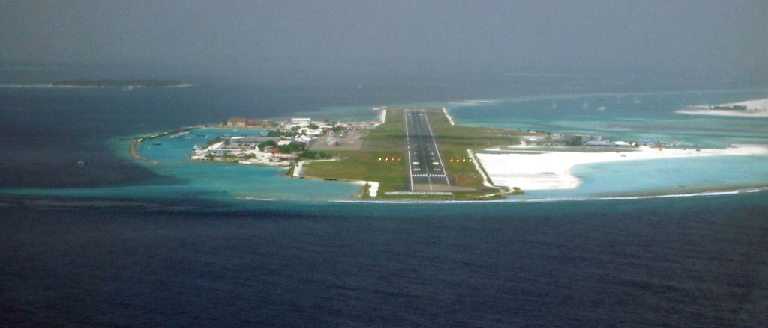
Island Inundation – What to do about it?
Continue to make meager adaptations to stem the loss of life in the face of increasingly frequent severe weather events?
Continue to appeal to high carbon emitting states to stem the output of atmospheric green house gasses in an effort to save their country from destruction.
Notes:
You may wish to choose one or the other from this or the previous slide if you wish to engage the students in a discussion about the posed questions.
Aerial view of Malé International Airport (VRMM), in the direction of Runway 36 – shows how very little elevation is available above current sea level.
Image source: PalawanOz [Public domain], from Wikimedia Commons; https://commons.wikimedia.org/wiki/File:Maldives_Approach_Finals_-_Rwy_36_Short_Finals_1.jpg

