Slide 1
Review:
https://www.youtube.com/watch?v=PFxpJkMXhwg
https://www.youtube.com/watch?v=gaFjlZxM7S4&t=9s

Slide 2
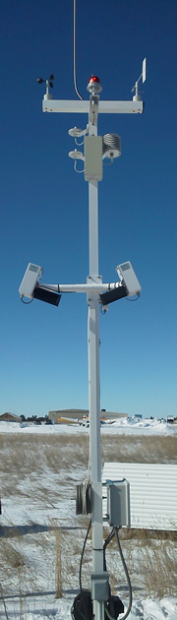
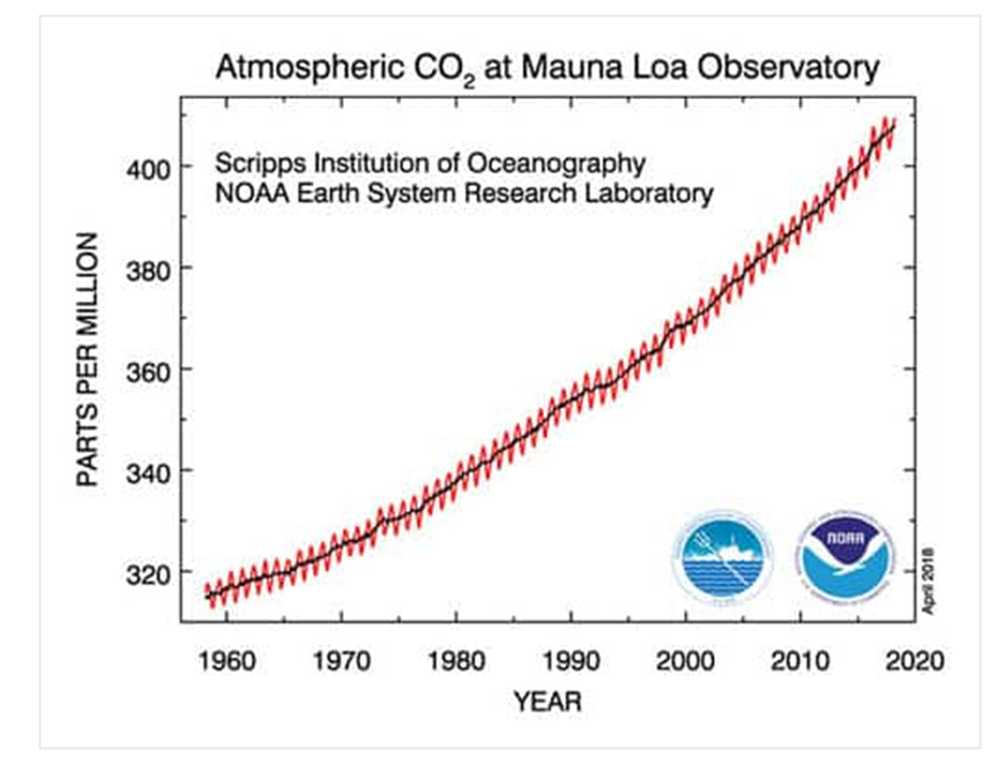
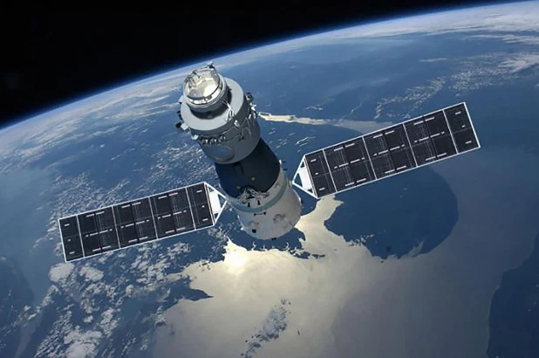
Past and Future Climate
Direct Observations: INSTRUMENTAL METEOROLOGY (thermometers, rain gauge, satellite data, etc…)
Keeling Curve
atmospheric chemical composition

Slide 3
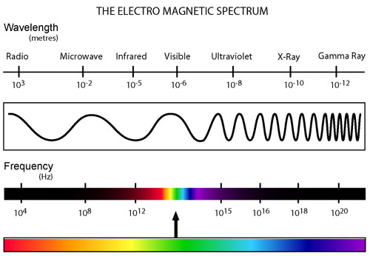
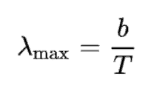
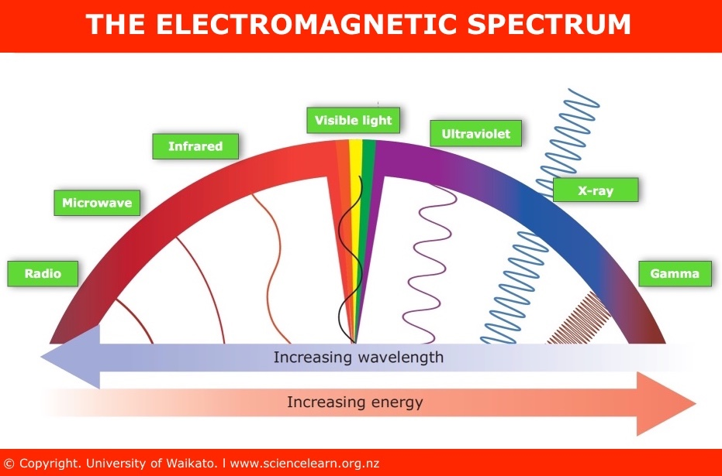
Wien’s Law: the wavelength of radiation is inversely proportional to its temperature
b = Wien’s displacement constant (2.8978 × 10⁻³ K.m)

Slide 4
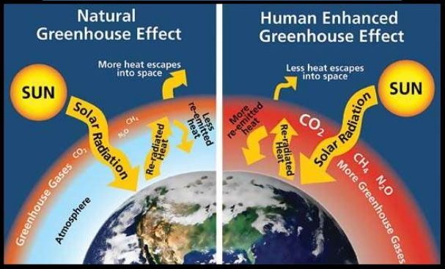
The Greenhouse Effect
short wave versus long wave radiation
https://www.youtube.com/watch?v=3JX-ioSmNW8&feature=emb_imp_woyt
Objects at a higher temperature radiate energy at lower wavelengths.
The greenhouse effect “traps” in longer wavelengths radiated from the earth.
Anthropogenic (human enhanced)

Slide 5
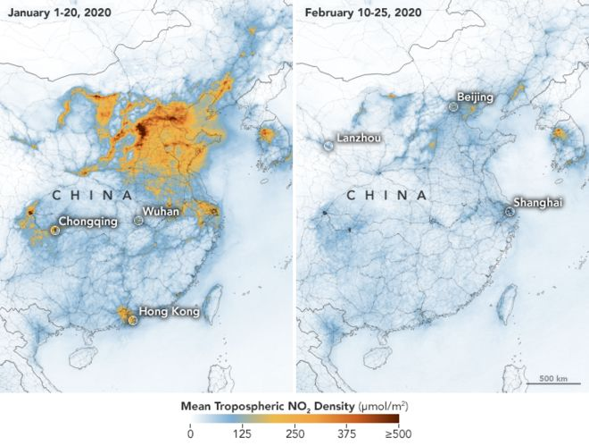
NATURAL versus ANTHROPOGENIC sources of greenhouse gases
Satellite images have shown a dramatic decline in pollution levels over China, which is "at least partly" due to an economic slowdown prompted by the coronavirus, US space agency Nasa says.
https://www.bbc.com/news/world-asia-51691967

Slide 6
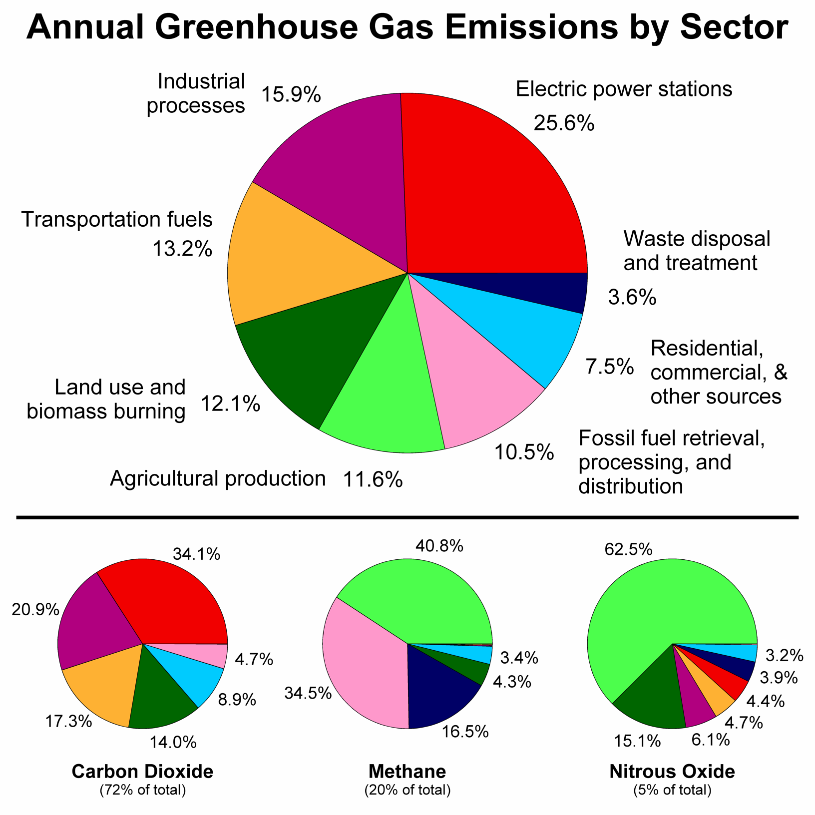
Greenhouse gases are those that absorb and emit infrared radiation in the wavelength range emitted by Earth.
Without greenhouse gases, the average temperature of Earth's surface would be about −18 °C (0 °F), rather than the present average of 15 °C (59 °F).
The major constituents of Earth's atmosphere, nitrogen (N2)(78%), oxygen (O2)(21%), and argon (Ar)(0.9%), are not greenhouse gases.
In order, the most abundant greenhouse gases in Earth's atmosphere are:
Water vapor (H2O)
Carbon dioxide (CO2) lifetime: 30–95 years
Methane (CH4) lifetime: 12 years
Nitrous oxide (N2O) lifetime: 121 years

Slide 7
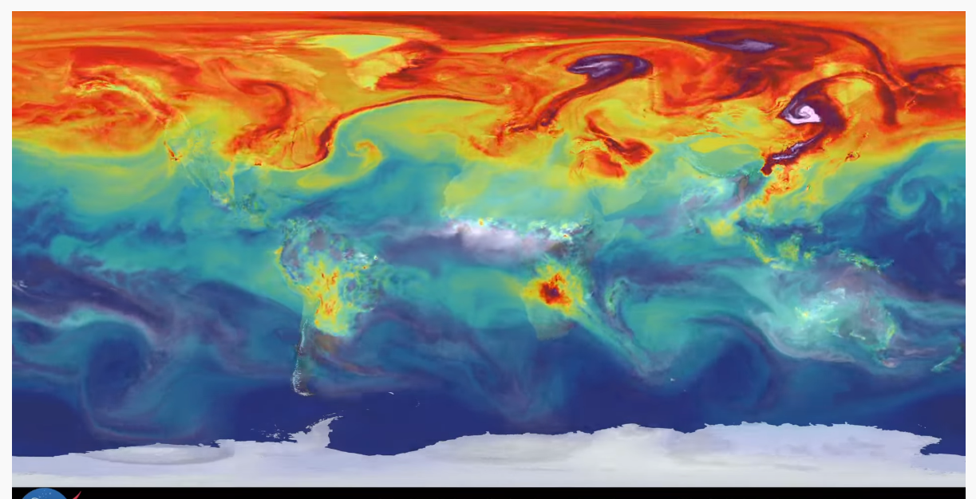
https://www.youtube.com/watch?v=x1SgmFa0r04
carbon dioxide animation for one year (2006)

Slide 8
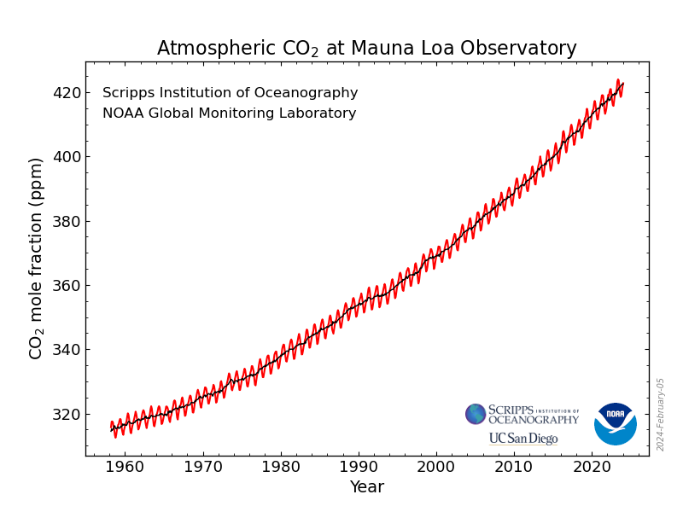
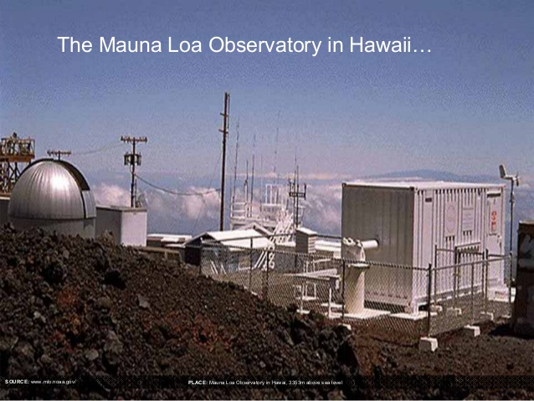
KEELING CURVE
Continuous time series of observed atmospheric CO2
Named after Charles Keeling who started the monitoring program in 1958, which continues to the present.
280 ppm in 1958 to 422.8 ppm in Jan 2024
https://gml.noaa.gov/ccgg/trends/

Slide 9
PALEOCLIMATE
Indirect Observations: PROXY RECORDS (ice cores, tree rings, corals, cave stalagmites)
Ice cores: temperature and chemical composition
precise dating techniques. (uranium-mass spectrometry)
- through growth banding: organic, inorganic deposits containing trace elements, oxygen and carbon are preserved with little change.
trees add a new layer of growth each year.
Width of ring is an indicator.
Wide indicates wet season , narrow indicate dry season

Slide 10
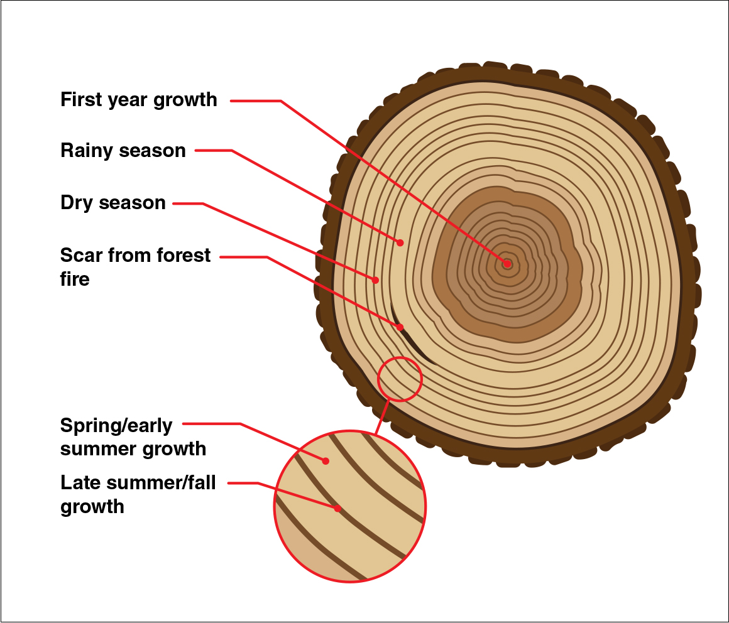
https://www.youtube.com/watch?time_continue=122&v=-lQvULoG25o&feature=emb_logo

Slide 11
How do we test for past climates?
Measurement of two naturally occurring stable isotopes of carbon:
1. 12 C: most abundant (99%)
2. 13 C: remaining (1%)
Mixing Ratio: 13C/ 12C
Emissions from anthropogenic sources, burning fossil fuels, removal of vegetation, have:
1. Mixing ratio less than atmospheric C02 0.035% volume mixing ratio
2. Carries a unique signature of its source:
Predictable decrease rate of 13 C/ 12 C associated with each source.

Slide 12
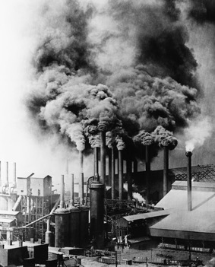
Climate change over the past century
https://www.youtube.com/watch?v=nlu21CNd34Q&list=PL38EB9C0BC54A9EE2&index=4
INDUSTRIAL REVOLUTION
• 18th - 19th century shift from agrarian societies in America and Europe to industrial societies.
• Mass production by machinery steam engine- central of revolution communication(telegraph) and transportation greatly improved.
Britain head start in 1700’s-stable economy, iron ore deposits and coal, workforce
• the revolution marked an end to rampant diseases, malnutrition and poor wages.
• textile industry transformed via mechanical inventions that improved efficiency. (e.g spinning thread)

Slide 13
iron & steel industry advanced to become critical to the development of appliances, tools and machines, to ships, buildings and infrastructure.
• By the early 20th century, the U.S. had become the world’s leading industrial nation.
• in essence: rural societies gave-way to urban ones with improved standard of life for middle and upper class…
• poor remained just that.
according to the IPCC the global average surface temperature has increased over the 20th century by about 0.74°C.
IPCC intergovernmental panel on climate change
AR5 5th assessment report on climate change 2014
AR6 6th assessment report on climate change 2023
RCP representative concentration pathway
SSP shared socioeconomic pathway
https://www.ipcc.ch/reports/

Slide 14
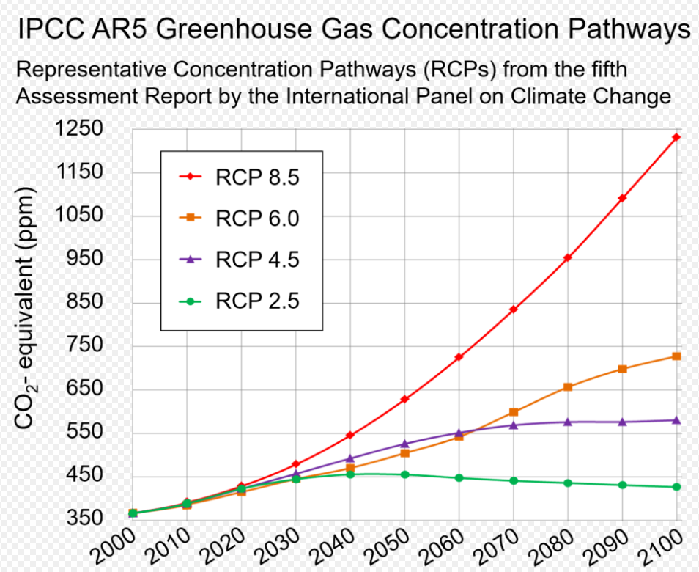
RCP
Four pathways have been selected for climate modeling and research, which describe different climate futures, all of which are considered possible depending on how much greenhouse gases are emitted in the years to come. The four RCPs, namely RCP2.6, RCP4.5, RCP6, and RCP8.5, are labelled after a possible range of radiative forcing values in the year 2100 (2.6, 4.5, 6.0, and 8.5 W/m², respectively).

Slide 15
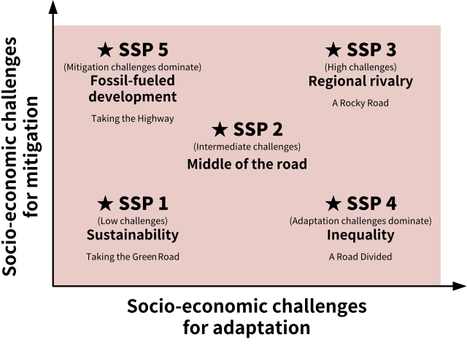
What is SSP vs RCP scenarios?
Currently widely used RCP scenarios are based on how future greenhouse gas concentrations will change. In contrast, SSP scenarios are that predict how climate change will change in response to socio-economic indicators such as population, economy, land use, and energy change.

Slide 16
