Slide 1
Guiding questions
What is the IPCC and how is it different from and relate to the UNFCCC?
What were the four main conclusions of the IPCC 1.5C report?

Slide 2
WHAT IS THE IPCC?
(www.ipcc.ch)
The Intergovernmental Panel on Climate Change (IPCC) is the UN body for assessing the science related to climate change. It was established by the United Nations Environment Programme (UNEP) and the World Meteorological Organization (WMO) in 1988 to:
1) provide policymakers with regular scientific assessments concerning climate change, its implications and potential future risks
2)put forward adaptation and mitigation strategies.
It has 195 member states.
IPCC assessments provide governments, at all levels, with scientific information that they can use to develop climate policies.
IPCC assessments are a key input into the international negotiations to tackle climate change.
IPCC reports are drafted and reviewed in several stages, thus guaranteeing objectivity and transparency.
The IPCC assesses the thousands of scientific papers published each year to inform policymakers about the state of knowledge on climate change. The IPCC identifies where there is agreement in the scientific community, where there are differences and where further research is needed. It does not conduct its own research.

Slide 3
IPCC
Mostly volunteers, nominated by governments
Have produced regular Assessment Reports since 1990 from three working groups (Science, Impacts and Adaptation, Mitigation) as well as Special Reports on particular topics such as Oceans and Land
Reports are summaries of published research
Received the Nobel Peace Prize in 2007

Slide 4
IPCC WORKING GROUPS
Working Group I : The Physical Science Basis. Working Group I examines the physical science underpinning past, present, and future climate change.
Working Group II : Impacts, Adaptation and Vulnerability. Working Group II assesses the vulnerability of socio-economic and natural systems to climate change, negative and positive consequences of climate change and options for adapting to it.
Working Group III : Mitigation of Climate Change. Working Group III focuses on climate change mitigation, assessing methods for reducing greenhouse gas emissions, and removing greenhouse gases from the atmosphere.

Slide 5
UNFCCC (UN Framework Convention on Climate Change)
United Nations convention signed in 1992 to reduce risks of dangerous anthropogenic climate change
Political process between countries who meet regularly to negotiate policies to reduce emissions (mitigation), adapt to warming, climate finance etc.
Benchmark agreements include Kyoto protocol in 1997 and Paris agreement in 2015

Slide 6
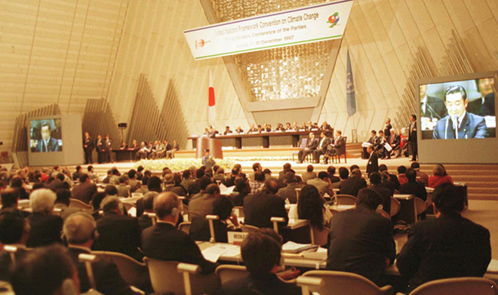
KYOTO PROTOCOL
International treaty which extends the 1992 United Nations Framework Convention on Climate Change (UNFCCC) that commits state parties to reduce greenhouse gas emissions, based on the scientific consensus that:
(part one) global warming is occurring and
(part two) it is extremely likely that human-made CO2 emissions have predominantly caused it.
adopted in Kyoto, Japan on 11 December 1997
entered into force on 16 February 2005.

Slide 8
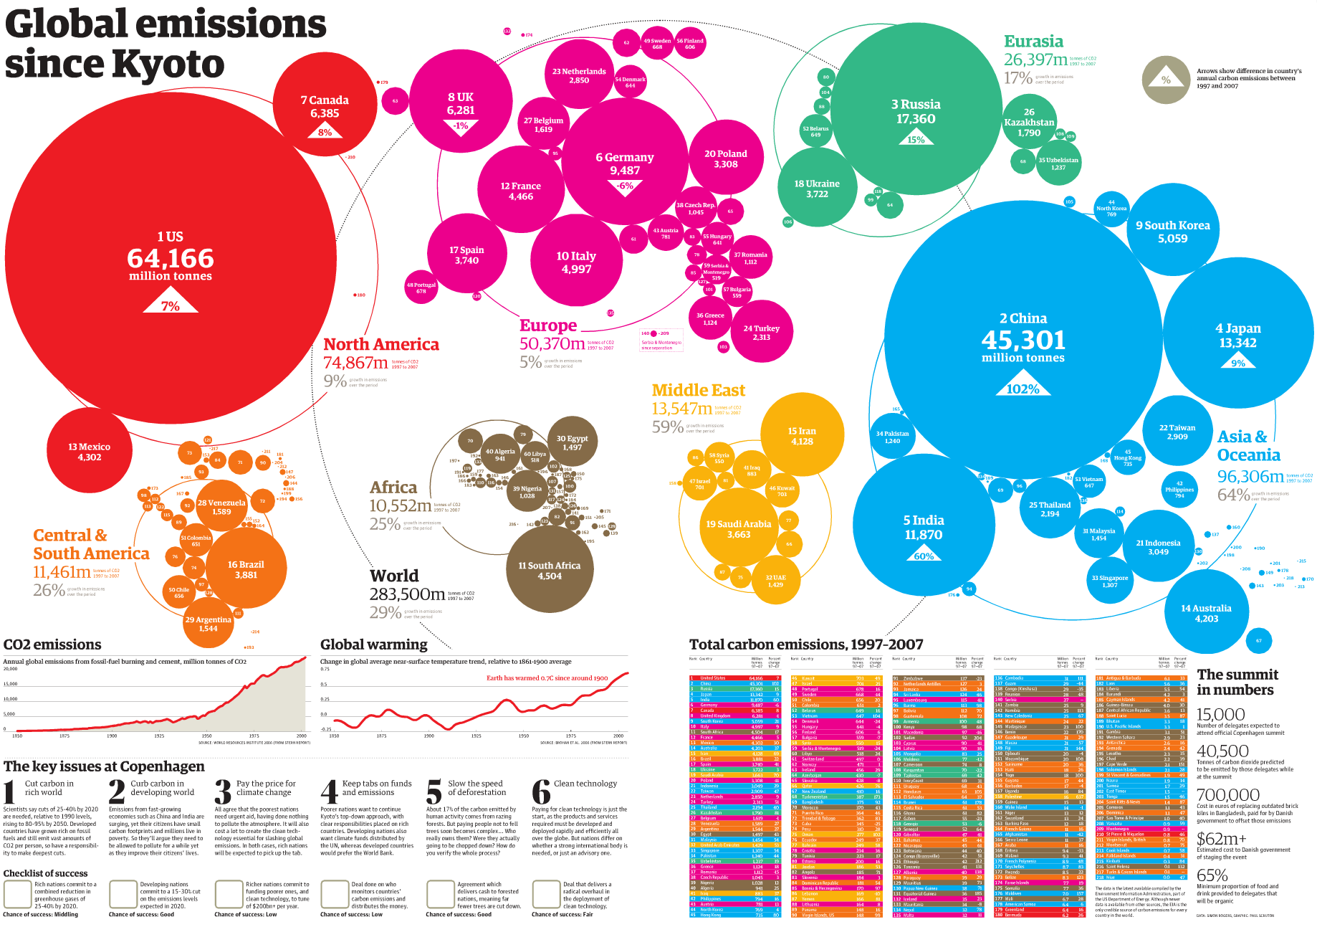

Slide 9
The Paris Agreement (2015) called for a balance of climate finance between adaptation and mitigation, and specifically underscoring the need to increase adaptation support for parties most vulnerable to the effects of climate change, including Least Developed Countries and Small Island Developing States.
A global framework to avoid dangerous climate change by limiting global warming to well below 2°C and pursuing efforts to limit it to 1.5°C.
aims to strengthen countries' ability to deal with the impacts of climate change and support them in their efforts.

Slide 10
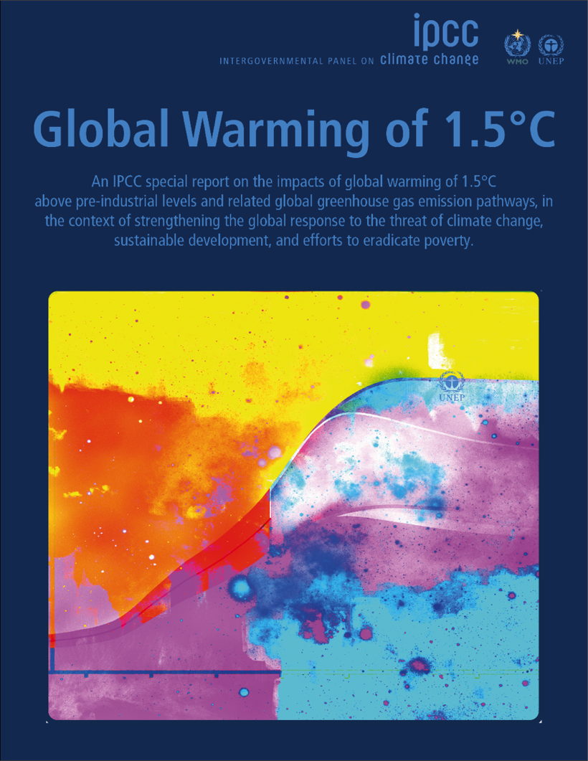
The IPCC 1.5C report
Requested by vulnerable countries in the 2015 Paris Agreement
91 authors,40 countries
18 month timeline with 5 international meetings on 4 continents
Reviewed 6000+ papers
42,000 comments from scientists and governments
https://www.ipcc.ch/sr15/

Slide 11
IPCC 1.5C report key questions
How much warming has already happened and what are the impacts?
What is a ‘safe’ level of warming (1.5ºC/2.7ºF vs 2ºC/3.6ºF)?
How do we limit warming to safe levels by reducing emissions and adapt to warming already underway?
What are the implications for sustainable development?

Slide 12
IPCC SR1.5 main conclusions
Climate has warmed almost 1ºC from preindustrial and without further action temperatures could rise above 3.5°C (6.3F)
Every bit of warming matters, losses increase significantly from 1.5ºC to 2ºC
Limiting warming to 1.5ºC requires deep cuts in emissions (~50% by 2030)
Even a warming of 1.5ºC undermines many development goals

Slide 13
Most vulnerable nations
Small low lying island states e.g. Kiribati, Maldives
Areas already hot, dry and poor (southern and eastern Africa, Central American dry corridor, SW tribal lands)
Arctic regions
Island of Kiribati
https://cop23.com.fj/cop23-pacific-photo-competition/humans-of-kiribati/

Slide 14
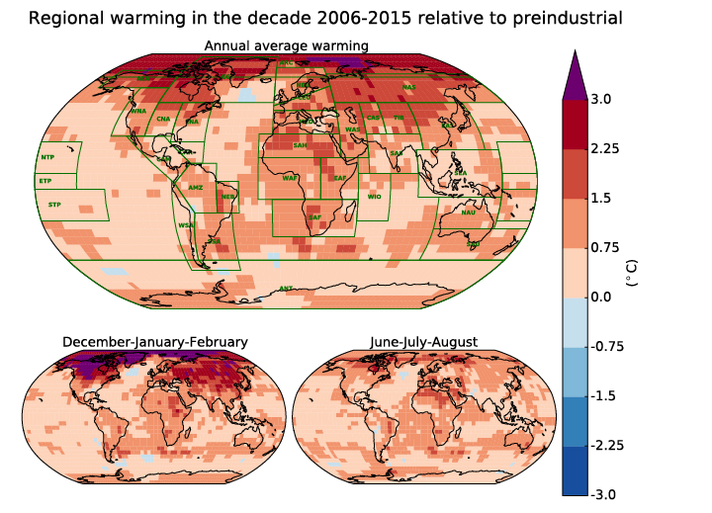
The observed 1°C (1.8°F) increase in global average temperature is higher over land, Arctic, drylands and at night

Slide 15
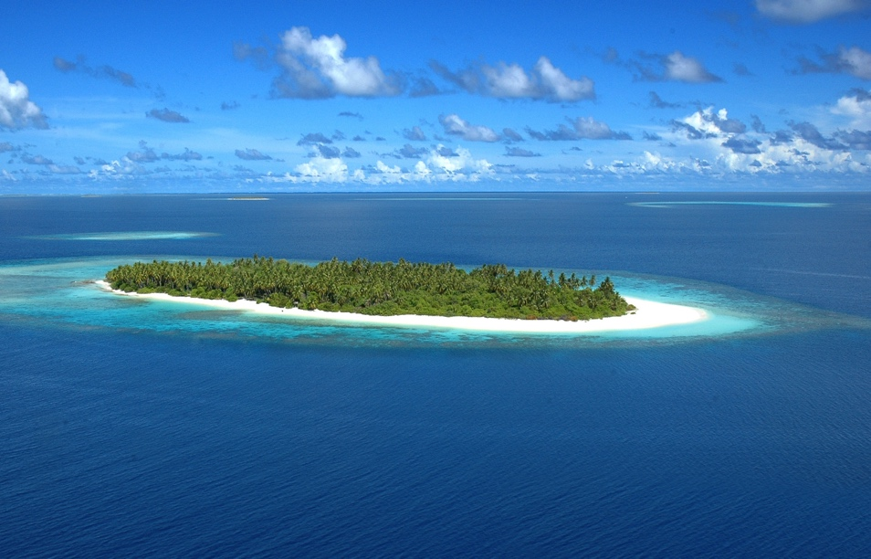
We have already observed impacts on ecosystems and livelihoods
Limiting warming to 1.5ºC (rather than 2ºC or higher) significantly reduces losses
At 1.5ºC tropical corals survive, at 2ºC they disappear
Risks of habitat loss for many species are 50% less at 1.5ºC
1.5C halves people exposed to water stress and heat waves
Reduces vulnerability to sea level rise and poverty and costs of adaptation
World Bank

Slide 16
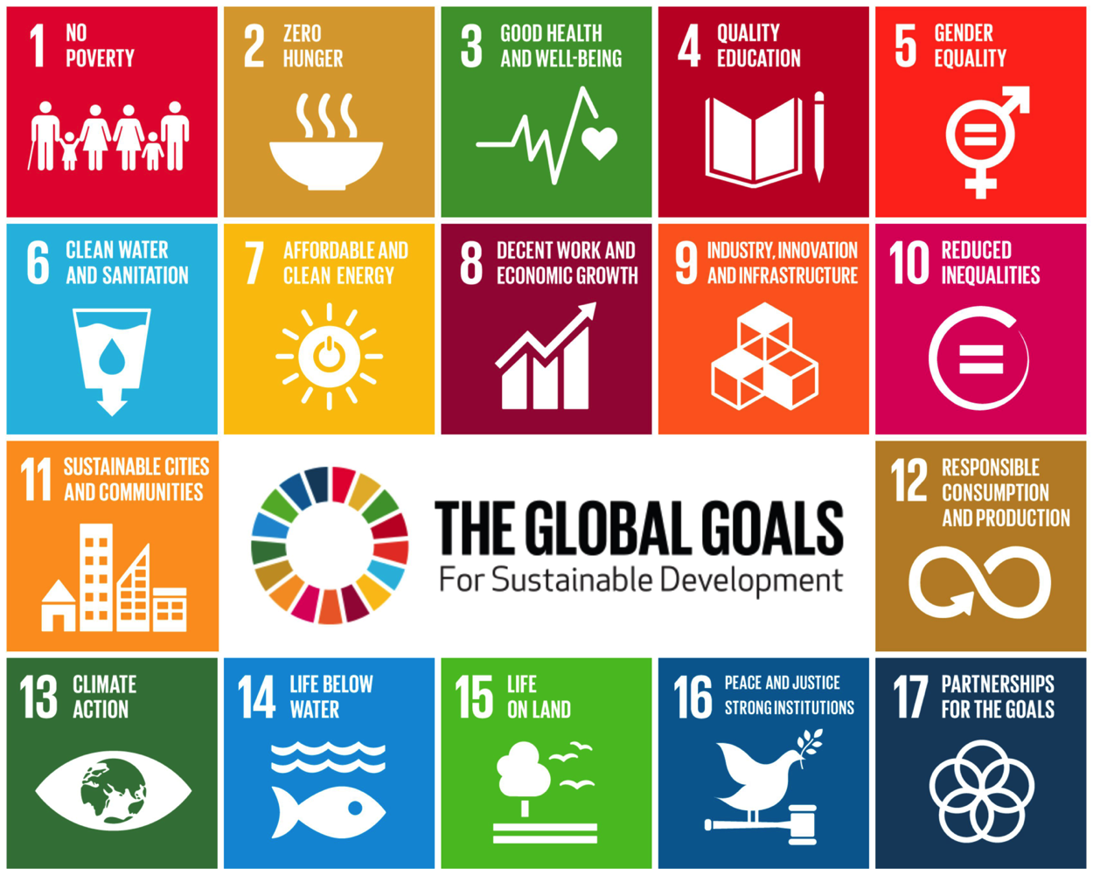
Global warming will undermine sustainable development
Climate impacts will make it difficult to achieve the Sustainable Development Goals (SDGs) - more so at 2ºC than 1.5ºC
Eradicating poverty and hunger
Securing health, wellbeing and clean water
Reducing inequality between and within countries
Protecting life below water and life on land

Slide 17
We are a long way from limiting warming to 1.5°C with current policies and commitments
IPCC SR1.5C Chapter 1

Slide 18
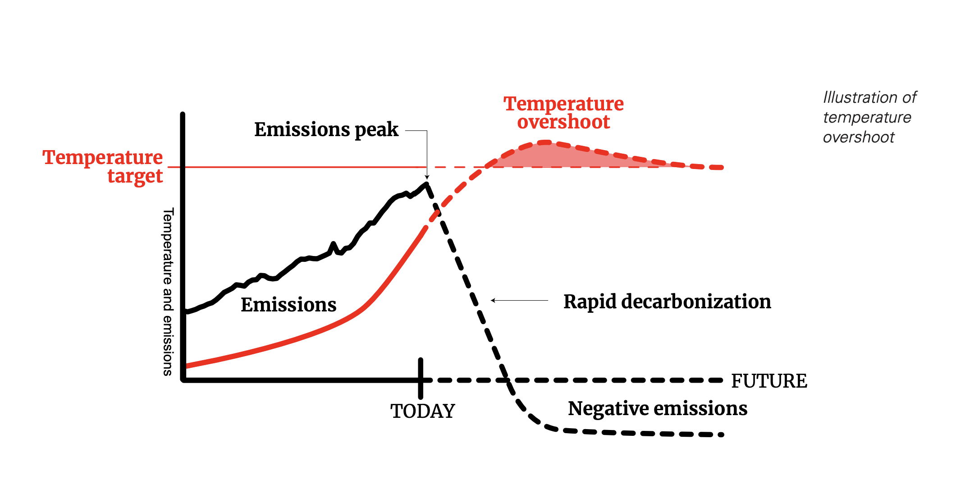
Can we limit warming to 1.5ºC?
Yes, we can, but it is very challenging and requires steep cuts in emissions (50% by 2030, net zero by 2050)
We also need negative emissions
Any delay makes it harder and increases chances of overshoot

Slide 19
What are negative emissions?
Options that remove greenhouse gases from the atmosphere
Planting trees and other practices that take up carbon
Bioenergy for liquid fuels (BECCS)
Carbon Capture and Storage

Slide 20
Mitigation options considered in IPCC report
Rapid transition from fossil fuels to renewables, nuclear, and bioenergy
Increases in energy efficiency
Reduced energy demand
Dietary changes
Protection and expansion of forests and carbon sinks
Carbon capture and storage (CCS) technology after 2030

Slide 21
Possible pathway to 1.5C Energy System change from 2010 to 2050
Action | 2030 | 2050
Emissions | -47% | -95%
Energy Demand | -5% | 2%
Energy from Coal | -61% | -77%
Energy from Oil | -13% | -50%
Energy from Gas | -20% | -53%
Energy from Nuclear | +83% | +98%
Energy from renewables (wind, solar, hydro, geothermal) | +470% | +1327%
Forests, CCS+Bioenergy | +348 GT | +151 GT

Slide 22
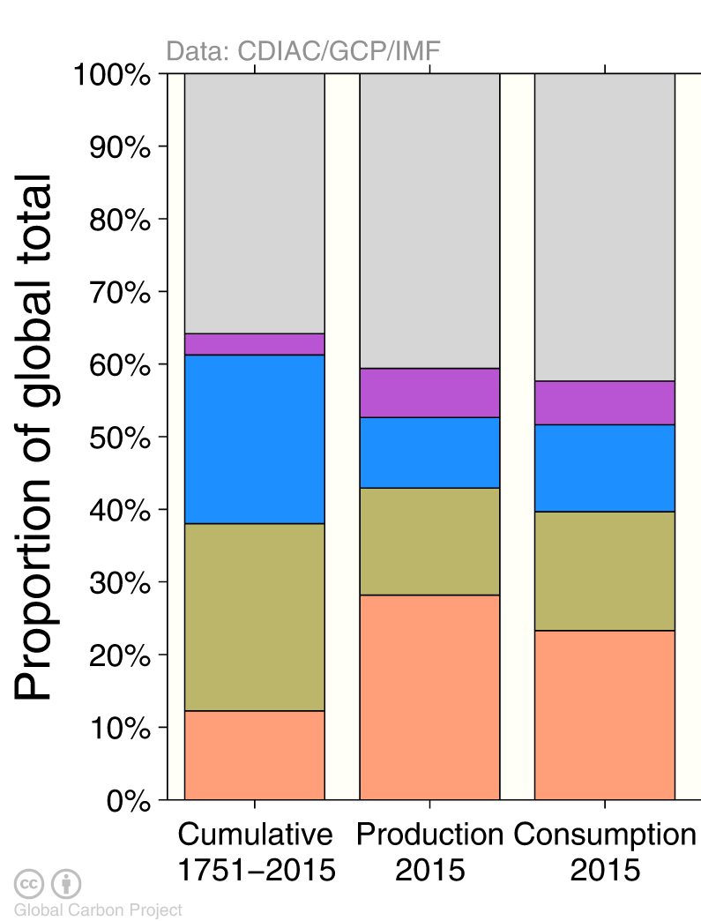
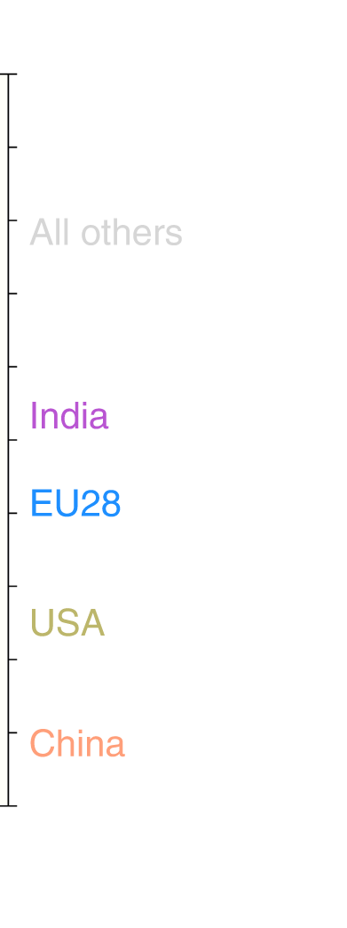
IPCC did not address equity in reducing emissions…
How should make those steep reductions in emissions?
Equal (50%) percent?
Greater reductions for larger historical or per capita emitters (such as USA)?
1.7 t/c
6.4 t/c
16.5 t/c
7.5 t/c
Holz, C., Kartha, S. and Athanasiou, T., 2018. Fairly sharing 1.5: National fair shares of a 1.5 C-compliant global mitigation effort. International Environmental Agreements: Politics, Law and Economics, 18(1), pp.117-134.

Slide 23
The longer we wait….
Larger and faster reductions will need to be made
We rely more on bioenergy and CCS
Higher the risk of temperature overshoot and associated impacts
Adaptation will be more difficult
We will undermine the SDGs

